Slide 1
Metamorphism
3rd level geology
Dr. Moustafa M. Mogahed

Slide 2
Definition
Metamorphism is defined as follows:
The mineralogical and structural adjustment of solid rocks to physical and chemical conditions that have been imposed at depths below the near surface zones of weathering and diagenesis and which differ from conditions under which the rocks in question originated.
Any type of rock—igneous, sedimentary, or metamorphic—can become a metamorphic rock. All that is needed is enough heat and/or pressure to alter the existing rock’s physical or chemical makeup without melting the rock entirely.

Slide 3
Rocks change during metamorphism because the minerals need to be stable under the new temperature and pressure conditions. The need for stability may cause the structure of minerals to rearrange and form new minerals. Ions may move between minerals to create minerals of different chemical composition

Slide 4
Definition
Meta means ‘change’, Morph means ‘form’
A change in form of pre-existing rocks of all types. Sedimentary, igneous and metamorphic
By the action of Heat alone (Contact)
By the action of Pressure alone (Dynamic)
By the action of Heat and Pressure in combination (Regional)

Slide 5
Metamorphism Excludes:
Weathering, diagenesis and lithification
Environments where temperatures are below 200 – 300 degrees centigrade
Melting Of Rocks - environments where temperatures are above 650 degrees centigrade
Environments less than 2km depth and at pressures below 1000 bars

Slide 6
During metamorphism the mineral content and texture of the protolith are changed due to changes in the physical and chemical environment of the rock. Metamorphism can be caused by burial, tectonic stress, heating by magma, or alteration by fluids. At advanced stages of metamorphism, it is common for a metamorphic rock to develop such a different set of minerals and such a thoroughly changed texture that it is difficult to recognize what the protolith was.

Slide 7
A rock undergoing metamorphism remains a solid rock during the process. Rocks do not melt during most conditions of metamorphism. At the highest grade of metamorphism, rocks begin to partially melt, at which point the boundary of metamorphic conditions is surpassed and the igneous part of the rock cycle is entered.

Slide 8
Even though rocks remain solid during metamorphism, fluid is generally present in the microscopic spaces between the minerals. This fluid phase may play a major role in the chemical reactions that are an important part of how metamorphism occurs. The fluid usually consists largely of water.

Slide 9
Metamorphic rocks provide a record of the processes that occurred inside Earth as the rock was subjected to changing physical and chemical conditions. This gives the geologist literally “inside information” on what occurs within the Earth during such processes as the formation of new mountain ranges, the collision of continents, the subduction of oceanic plates, and the circulation of sea water into hot oceanic crust. Metamorphic rocks are like probes that have gone down into the Earth and come back, bringing an record of the conditions they encountered on their journey in the depths of the Earth.

Slide 10
In the large outcrop of metamorphic rocks, the rocks’ platy appearance is a result of the process metamorphism. Metamorphism is the addition of heat and/or pressure to existing rocks, which causes them to change physically and/or chemically so that they become a new rock. Metamorphic rocks may change so much that they may not resemble the original rock.

Slide 11
Metamorphic Grade
The extent to which the pre-existing rocks have been changed in form/altered
Low Grade – slight alteration
Medium Grade – significant alteration
High Grade – extensive/total alteration

Slide 12
Metamorphic Grade
As the temperature and/or pressure increases on a body of rock we say the rock undergoes prograde metamorphism or that the grade of metamorphism increases. Metamorphic grade is a general term for describing the relative temperature and pressure conditions under which metamorphic rocks form.

Slide 13
Metamorphic Grade
Low-grade metamorphism takes place at temperatures between about 200 to 320ºC, and relatively low pressure. Low grade metamorphic rocks are generally characterized by an abundance of hydrous minerals. With increasing grade of metamorphism, the hydrous minerals begin to react with other minerals and/or break down to less hydrous minerals.

Slide 14
Metamorphic Grade
High-grade metamorphism takes place at temperatures greater than 320ºC and relatively high pressure. As grade of metamorphism increases, hydrous minerals become less hydrous, by losing H₂O, and non-hydrous minerals become more common.

Slide 15
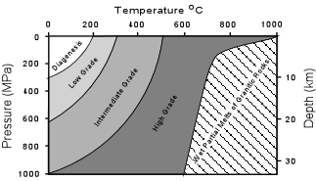
Metamorphic Grade

Slide 16
Metamorphic Changes
Are assumed to be isochemical
The bulk chemical composition of the parent rock and the metamorphic product are identical.
Both contain the same % Si, Al, O, Na etc.
The only loss from the system is water as hydrous clay minerals are dehydrated by a rise in temperature

Slide 17
Contact Metamorphism
Changes due to the action of heat alone
Associated with large scale igneous bodies
Batholiths and plutons of granite/gabbro
Example around the edges of the granites in Um Had Eastern Desert, Egypt.
Metamorphic aureole refers to the volume of rock affected by heat from the intrusion

Slide 18
Controlling Factors - Contact
Size and shape of the igneous body
Composition – Acid magma 800 degrees centigrade, basic magma 1200 degrees
Thermal conductivity of the country rocks
Volatile content of the magma
Distance from edge of igneous body of any location in the country rocks

Slide 19
The Metamorphic Aureole
The total volume of older ‘country rocks’ affected by heat from the intrusion
Grade of metamorphism decreases from the intrusion towards the edge of the aureole
By convention aureoles need to be over 50 metres wide to be marked on 1:50,000.

Slide 20
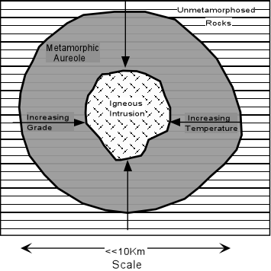
The Metamorphic Aureole

Slide 21
Argillaceous Rocks
Argillaceous minerals may appear silvery upon optical reflection and are minerals containing substantial amounts of clay-like.
Argillaceous components are fine-grained (less than 2 µm) aluminosilicates, and more particularly clay minerals such as kaolinite, montmorillonite-smectite, illite, and chlorite. Claystone and shales are thus predominantly argillaceous.
The adjective "argillaceous" is also used to define rocks in which clay minerals are a secondary but significant component. For example, argillaceous limestones are limestones consisting predominantly of calcium carbonate, but including 10-40% of clay minerals: such limestones, when soft, are often called marls. Similarly, argillaceous sandstones are sandstones consisting primarily of quartz grains, with the interstitial spaces filled with clay minerals

Slide 22
Contact Metamorphism Of Argillaceous Rocks
Argillaceous rocks which have undergone metamorphism are referred to as Pelites
Low Grade – Spotted Rock
Medium Grade – Chiastolite Rock
High Grade – Hornfels
Argillaceous rocks undergo most change as they are composed of chemically complex clay minerals such as kaolinite, illite, smectite, bentonite and montmorillianite.

Slide 23
Low Grade – Spotted Rock
Increased temperature to 300 – 400 degrees centigrade.
Partial recrystallization occurs
New minerals occur as oval spots 2 – 5mm in diameter. Cordierite or iron oxides
Spots show sieve or poikiloblastic texture Spots have overgrown and included grains of the original argillaceous rock
Relic structures such as bedding/lamination and fossils may be evident

Slide 24
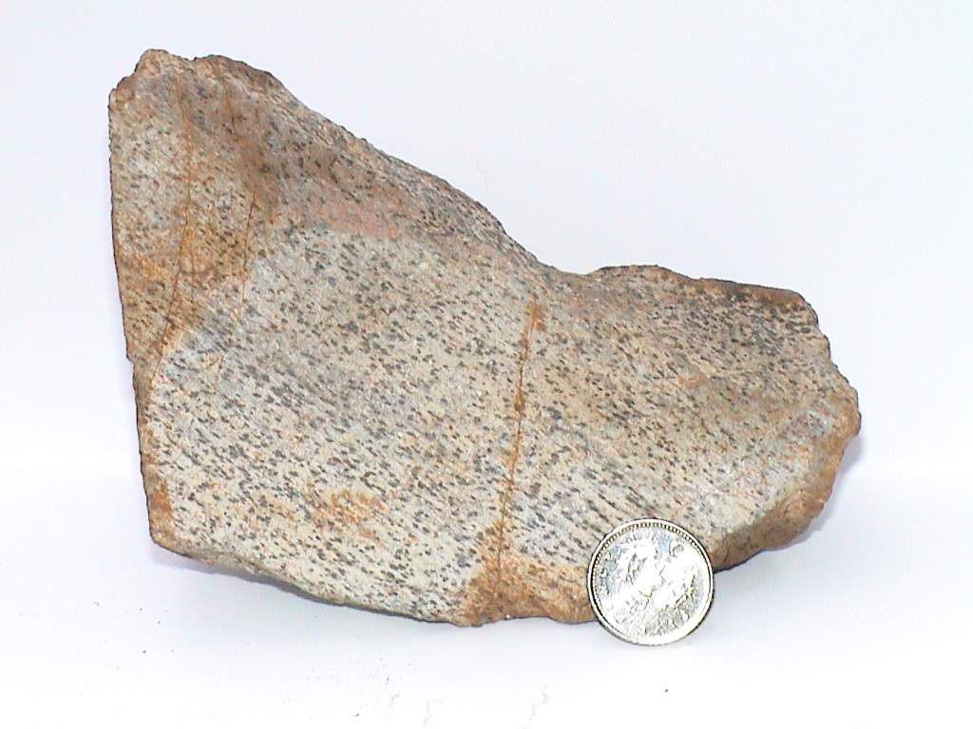
Spotted Rock - Chapel Porth , Cornwall
Spots 1-3mm in diameter, oval in shape, greenish colour and composed of cordierite
Laminations - relic structure of sedimentary rock, therefore low grade
Matrix/groundmass is fine grained/argillaceous and appears sedimentary in nature
Spots show sieve or poikiloblastic texture
Red/brown staining due to oxidation of iron compounds following chemical weathering
Spots concentrated along old lamination surfaces, sloping left to right in photograph

Slide 25
Medium Grade – Chiastolite Rock
Increase in temperature to 400 – 500 degrees centigrade, results in coarser grained rock
Extensive recrystallization occurs
Needles of chiastolite develop and show porphyroblastic texture. Up to 2cm long, 3mm in diameter, square cross section often with iron inclusions. Groundmass is mainly micas
Needles show random orientation, having crystallised in the absence of pressure
No relic structures are evident

Slide 26
Chiastolite
is a variety of the mineral andalusite with the chemical composition Al₂SiO₅. It is noted for distinctive cross-shaped black inclusions of graphite.
The chiastolite crystals have een pseudomorphically altered by a mixture of muscovite, paragonite and margarite. The calcium rich margarite tends to form along the graphite rich crosses or bands within the chiastolite. Mineralogically the occurrence is important because all three white mica phases are present in an equilibrium assemblage.

Slide 27
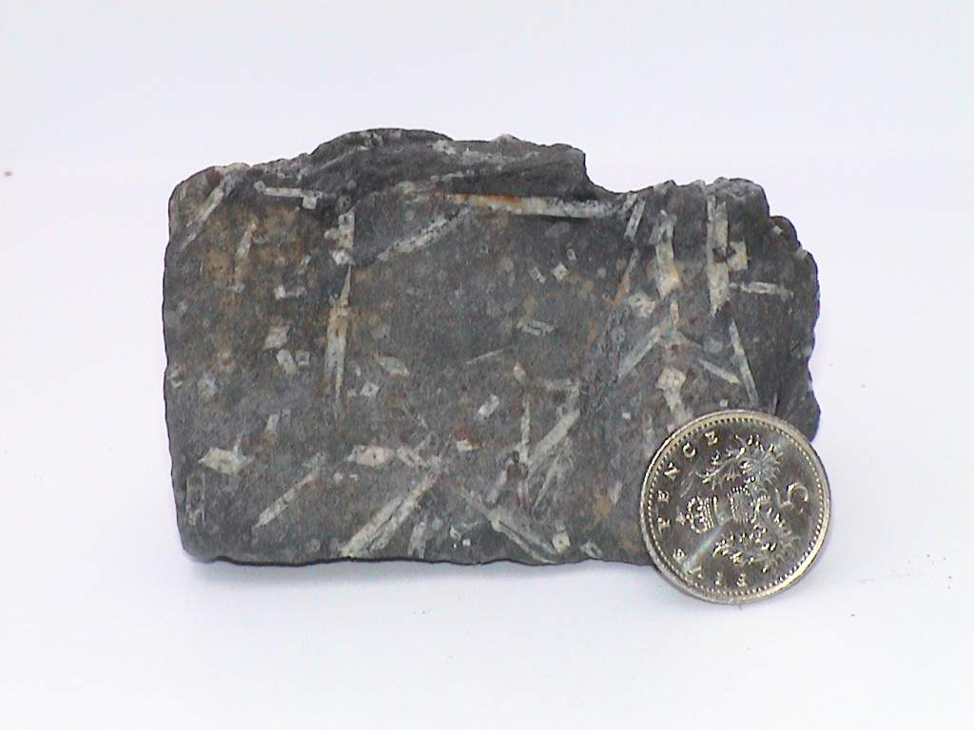
Chiastolite Rock/Chiastolite Hornfels
No evidence of former sedimentary structure remain
Needles show random orientation, having crystallised in the absence of directed stress
Porphyroblastic texture
Needles have square cross sections, often with iron inclusions
White chiastolite needles up to 2cm in length
Groundmass is very fine grained but crystalline
Shows crystalline rather than clastic texture

Slide 28
High Grade - Hornfels
Increase in temperature 500–600 degrees centigrade, results in grain size >2mm
Hornfels shows hornfelsic texture-a tough, fibrous and splintery-looking rock with a crystalline texture
Andalusite often occurs as porphyroblasts
No evidence of any relic structures

Slide 29
Hornfels is a metamorphic rock formed by the contact between mudstone / shale, or other clay-rich rock, and a hot igneous body, and represents a heat-altered equivalent of the original rock. This process is termed contact metamorphism. Because pressure is not a factor in the formation of hornfels, it lacks the foliation seen in many metamorphic rocks formed under high pressure and temperature regimes. Pre-existing bedding and structure of the parent rock is generally destroyed during the formation of hornfels. It is often difficult to identify hornfels without microscopic observation, or knowledge of its association with a magma body, as it is typically non-descript in hand specimen. Under a microscope the structure of hornfels is very distinctive, with small, generally equigranular, mineral grains fitting closely together like the fragments of a mosaic or a rough pavement.

Slide 30
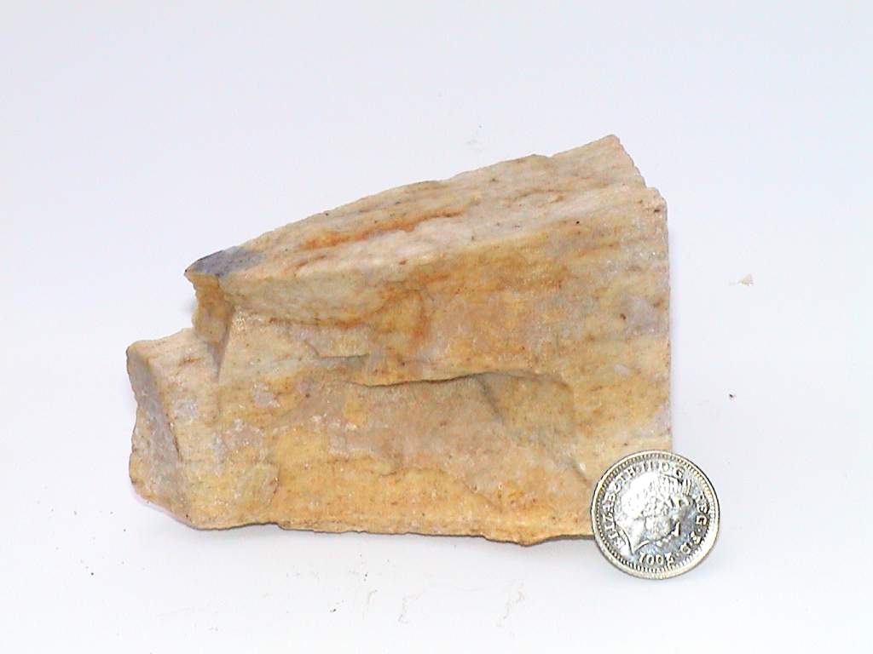
Hornfels – High Grade Contact Metamorphism
Hornfels/Killas-Cornwall
Medium to coarse grained 1-2mm
Formed from argillaceos parent material: clay/shale/mudstone
Crystalline texture
Tough, splintery hornfelsic texture
No evidence of former sedimentary structures
Formed adjacent to a major igneous intrusion

Slide 31
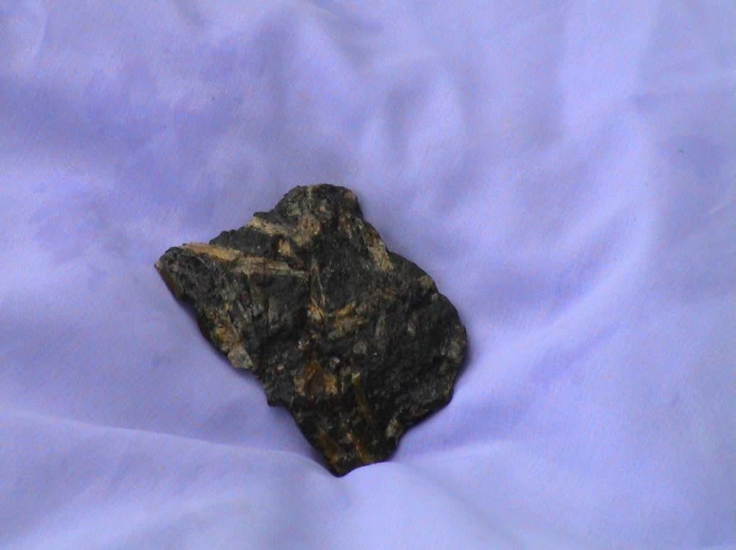
Andalusite Hornfels - Brittany
Tough, compact and splintery hornfelsic texture
Formed from argillaceous parent rocks: clay/shale/mudstone
Andalusite needles up to 3cm long x 5mm across
Porphyroblastic texture
Andalusite porphyroblasts show random orientation indicating crystallisation in the absence of directed stress
Crystalline groundmass dark grey in colour
High grade contact or thermal metamorphism
Andalusite is stable under high temperatures but relatively low pressures
All evidence of sedimentary structures destroyed
3 cm

Slide 32
Maculose structure:
Maculose structure:
It is produced by thermal metamorphism of argillaceous rocks like shales. Here, larger crystals of andalusite, cordierite and biotite are sometimes well developed giving a spotted appearance to the rocks. The well developed crystals are known as 'porphyroblasts' with increasing degree of metamorphism, the spotted slates pass into extremely fine grained granular rock known as Hornfels.

Slide 33
Contact Metamorphism Of Limestones 1
Limestones, including chalk are chemically simple rocks, comprising just calcium carbonate in the form of the mineral calcite.
No new can minerals form as there are only atoms of Ca, C and O present, instead calcium carbonate recrystallises in a coarser form
Grain size increases with grade. Low grade <1mm, Medium 1-2mm, High >2mm

Slide 34
Contact Metamorphism Of Limestones 2
Limestones recrystallise to form marble
All fossil detail and older structures are lost during recrystallisation
Marbles show granoblastic texture, where all the crystals are roughly the same size. This is the metamorphic equivalent of granular texture in igneous rocks.

Slide 35
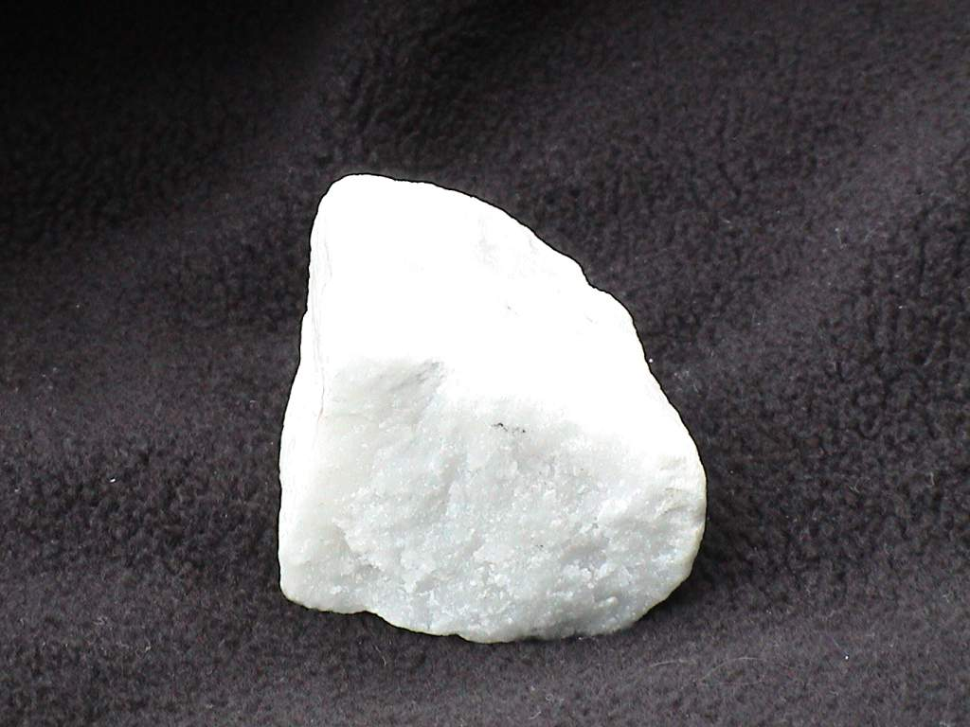
Marble – Italy
No evidence of foliation, therefore formed by contact metamorphism
Calcite crystals are hexagonal with 120 degree triple point junctions
Contact/thermal metamorphism of a pure limestone, hence white colour
Crystalline texture
Entirely composed of recrystallised calcium carbonate
White, sugary saccharoidal or granoblastic texture
Crystal size 1 – 2mm medium grade
No evidence of old sedimentary structures, therefore at least medium grade
Monomineralic rock-reacts with dilute hydrochloric acid and can be scratched easily with steel
2 cm

Slide 36
Contact Metamorphism Of Limestones 3
Pure limestones produce white marbles with a sugary or saccharoidal texture
Crystals show triple point junctions with 120 degree angles between adjacent crystals. Indicates crystallization in the absence of directed stress
Marbles can be distinguished from metaquartzites by testing with dilute acid and scratching with a steel nail
Marble reacts or fizzes (carbon dioxide is given off) and is scratched by the steel nail

Slide 37
Contact Metamorphism Of Sandstones 1
Sandstones are chemically simple rocks comprising mainly quartz (silicon dioxide)
No new minerals form from pure sandstones as there are only atoms of Si and O present. Instead, quartz recrystallises in a coarser form
Grain size increases with grade. Low grade <1mm, Medium 1-2mm, High >2mm

Slide 38
Contact Metamorphism Of Sandstones 2
Sandstones recrystallise to form metaquartzites
All fossil detail and older structures are lost during recrystallisation
Metaquartzites show granoblastic texture, where all the crystals are roughly the same size. This is the metamorphic equivalent of granular texture in igneous rocks.

Slide 39
Contact Metamorphism Of Sandstones 3
Crystals show triple point junctions with 120 degree angles between adjacent crystals. Indicates crystallization in the absence of directed stress
Metaquartzites can be distinguished from marbles by testing with dilute acid and scratching with a steel nail
Metaquartzite does not react with acid and is not scratched by a steel nail

Slide 40
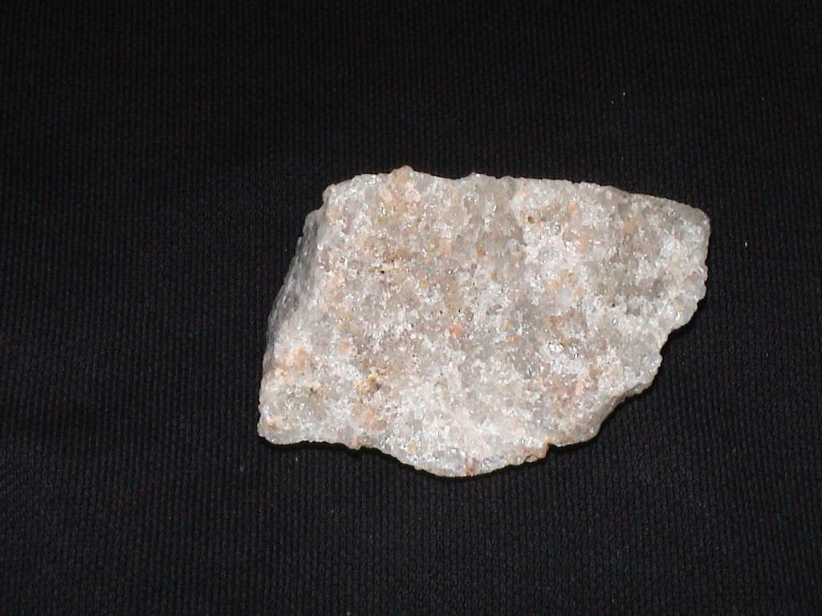
Contact Metamorphism Of Sandstone - Metaquartzite
Granoblastic texture, all crystals 1-2mm in diameter
Recrystallization has resulted in reduction in porosity
All evidence of former sedimentary structures destroyed
2cm
Mineralogy predominantly grey, glassy, colourless quartz
Crystals show triple point junctions at 120 degrees

Slide 41
Contact Metamorphism Of Impure Limestones and Sandstones
If limestones or sandstones contain an appreciable clay content, then new minerals will form
Spots of cordierite and needles of chiastolite and andalusite (porphyroblasts) will form as the metamorphic grade increases
The porphyroblasts will have a random orientation due to the absence of directed stress at the time of crystallization

Slide 42
Pressure
Rocks are generally metamorphosed at depth within the Earth where the temperatures are high. This cannot happen, of course, unless pressure increases also. Remember that the pressure increase with depth is due to the weight of overlying rocks, and is called lithostatic pressure (also called confining pressure).
Lithostatic pressure is generally considered to be equal in all directions (hydrostatic) similar to pressure in deep water. We assume this to be the case for many metamorphic environments.

Slide 43
If not, and the pressure in one direction were significantly greater than in another direction, the rock would yield until the motion offset the pressure difference. Such deformation occurs when the pressure differential exceeds a material's strength, which we can expect to occur below a relatively shallow zone of low pressure with relatively cool and brittle rocks. Rocks under lithostatic conditions, regardless of the pressure, will not change shape (i.e., deform). Pressure may cause a volume loss, but it will be uniform in all directions (just as the exerted pressure). This volume loss is facilitated by the formation of low-volume (high-density) minerals.

Slide 44
Deviatoric Stress
Only when the pressure is unequal in various directions will a rock be deformed. Unequal pressure is usually called deviatoric stress (whereas lithostatic pressure is uniform stress).
Stress is an applied force acting on a rock (over a particular cross-sectional area)
Strain is the response of the rock to an applied stress (= yielding or deformation)
Deviatoric stress can be maintained only if application keeps pace with the tendency of the rock to yield
This occur most often in orogenic belts, extending rifts, or in shear zones. (i.e. generally at or near plate boundaries)
Deviatoric stress affects the textures and structures, but not the equilibrium mineral assemblage

Slide 45
We can envision deviatoric stress as being resolvable into three mutually perpendicular stress (σ) components:
  σ₁ is the maximum principal stress
  σ₂ is an intermediate principal stress
  σ₃ is the minimum principal stress
In hydrostatic situations all three are equal

Slide 46
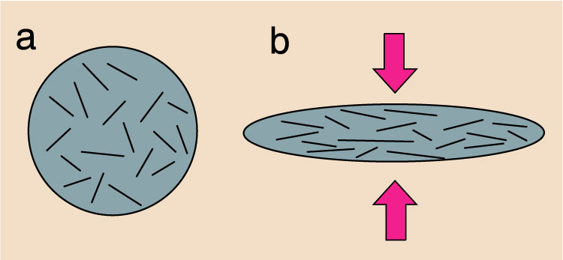
Foliation is a common result, which allows us to estimate the orientation of σ₁
σ₁
Strain ellipsoid
σ₁ > σ₂ = σ₃ → foliation and no lineation
σ₁ = σ₂ > σ₃ → lineation and no foliation
σ₁ > σ₂ > σ₃ → both foliation and lineation
Figure 21.3. Flattening of a ductile homogeneous sphere (a) containing randomly oriented flat disks or flakes. In (b), the matrix flows with progressive flattening, and the flakes are rotated toward parallelism normal to the predominant stress. Winter (2001) An Introduction to Igneous and Metamorphic Petrology. Prentice Hall.

Slide 47
Dynamic Metamorphism
Changes due to pressure alone
Associated with major fault planes, especially reverse and thrust faults.
Very localised, restricted to 1 or 2 metres immediately adjacent to the fault plane
Process is Cataclasis which involves crushing and grinding of rocks into angular fragments
Characteristic texture is cataclastic

Slide 48
Low Grade – Fault Breccia 1
Low to moderate pressures at shallow depths
< 5km below the surface
Angular clasts set in a matrix of micro-breccia, often later cemented by percolating solutions or groundwater
Long axes of clasts may show parallel/sub-parallel orientation to fault plane
Easily eroded away to form a gully at the surface if not cemented by percolating waters

Slide 49
Low Grade – Fault Breccia 2
Large clasts generally only produced by competent rocks such as sandstone and limestone
Argillaceous rocks produce fault-gouge, a fine clayish material devoid of larger angular clasts
There is some disagreement amongst geologists as to whether fault breccia and fault gouge represent true metamorphic rocks

Slide 50
Fault gouge
is an unconsolidated tectonite (a rock formed by tectonic forces) with a very small grain size. Fault gouge has no cohesion, it is normally an unconsolidated rock type, unless cementation took place at a later stage. A fault gouge forms in the same way as fault breccia, the latter also having larger clasts.
Origin
Fault gouge forms by tectonic movement along a localized zone of brittle deformation (a fault zone) in a rock. The grinding and milling that results when the two sides of the fault zone move along each other results in a material that is made of loose fragments. First a fault breccia will form, but if the grinding continues the rock becomes fault gouge.

Slide 51
Medium Grade - Mylonite
Moderate to high pressure 5 – 10km depth
Intense crushing/grinding occurs to reduce rock particles to microscopic angular fragments. Often called Rock Flour – as in the white plain flour for baking.
Texture is mylonitic. More competent components e.g. flint nodules in chalk are drawn out into lens shaped fragments on a microscopic scale

Slide 52
High Grade – Ultramylonite
Very high pressures, over 10km depth
Intense crushing/grinding generates frictional heat to weld the microscopic angular particles together
In extreme cases frictional heating can initiate localised melting and the formation of pseudotachylite glass

Slide 53
Prograde Metamorphism
Prograde: increase in metamorphic grade with time as a rock is subjected to gradually more severe conditions
  Prograde metamorphism: changes in a rock that accompany increasing metamorphic grade
Retrograde: decreasing grade as rock cools and recovers from a metamorphic or igneous event

Slide 54
The Progressive Nature of Metamorphism
A rock at a high metamorphic grade probably progressed through a sequence of mineral assemblages rather than hopping directly from an unmetamorphosed rock to the metamorphic rock that we find today
Notes:
Metamorphic rocks usually maintain equilibrium as grade increases
High-grade metamorphic rock probably progressed through a sequence of mineral assemblages as it adjusted to increasing temperature and pressure, rather than hopping directly from un-met to the metamorphic rock that we find today
If a metamorphosed sedimentary rock experienced a cycle of increasing metamorphic grade, followed by decreasing grade, at what point on this cyclic P-T-t path did its present mineral assemblage last equilibrate?
The zonal distribution of metamorphic rock types preserved in a geographic sequence of increased metamorphic grade suggests that each rock preserves the conditions of the maximum metamorphic grade (temperature) experienced by that rock during metamorphism

Slide 55
The Progressive Nature of Metamorphism
Retrograde metamorphism typically of minor significance
Prograde reactions are endothermic and easily driven by increasing T
Devolatilization reactions are easier than reintroducing the volatiles
Geothermometry indicates that the mineral compositions commonly preserve the maximum temperature
Notes:
Retrograde is usually detectable by observing textures, such as the incipient replacement of high-grade minerals by low-grade ones at their rims

Slide 56
METAMORPHISM
Metamorphic grade:
Q. if metamorphic grade is due to a progressive response by a rock to increasing temperature and pressure (prograde metamorphism), then why, when the rock is later exposed at the surface, doesn’t the rock return to its original form
A. sometimes it does, but only to a limited extent (retrograde metamorphism)

Slide 57
METAMORPHISM
Retrograde Metamorphism
As temperature and pressure fall due to erosion of overlying rock or due to tectonic uplift, one might expect metamorphism to a follow a reverse path and eventually return the rocks to their original unmetamorphosed state. Such a process is referred to as retrograde metamorphism.

Slide 58
Please answer the following question?
Which type of metamorphism is less common
Prograde or retrograde?
If your answer is prograde say why?
If your answer is retrograde thus,
Why is retrograde metamorphism uncommon?

Slide 59
If retrograde metamorphism were common, we would not commonly see metamorphic rocks at the surface of the Earth. Since we do see metamorphic rocks exposed at the Earth's surface retrograde metamorphism does not appear to be common. The reasons for this include:

Slide 60
chemical reactions take place more slowly as temperature is decreased.
during prograde metamorphism, fluids such as H2O and CO2 are driven off, and these fluids are necessary to form the hydrous minerals that are stable at the Earth's surface.
chemical reactions take place more rapidly in the presence of fluids, but if the fluids are driven off during prograde metamorphism, they will not be available to speed up reactions during retrograde metamorphism.

Slide 61
Regional Metamorphism
Occurs due to progressive increase in pressure and temperature conditions
Occurs on a regional scale and involves 000’s cubic kilometres of rock
Associated with destructive plate margins, especially subduction zones such as the Peru-Chile Trench
Regional metamorphic rocks show foliation, a banding/layering/alignment of crystal long axes as they crystallised under directed stress

Slide 62
Regional Metamorphism Of Argillaceous Sediments
Argillaceous rocks are referred to as pelites or pelitic following metamorphism
Argillaceous rocks undergo most change as they are composed of chemically complex clay minerals such as kaolinite, illite, smectite, bentonite and montmorillianite.
Low Grade – Slate, Medium Grade – Schist
High Grade – Gneiss , V. High Grade - Migmatite

Slide 63
Low Grade – Slate 1
Occurs at 5 – 15 km depth, relatively high pressures but low temperatures < 300 degrees centigrade. Upper part of the subduction zone
New minerals mainly chlorite and biotite. These platy minerals have their long axes aligned and at right angles to the principal stress direction to form slaty cleavage

Slide 64
Low Grade – Slate 2
Grain size has increased but crystals too small to see with the naked eye
At low grade, some relic sedimentary structures may be preserved such as bedding or lamination.
Fossils may be present but will be deformed ie stretched, elongated or compressed

Slide 65
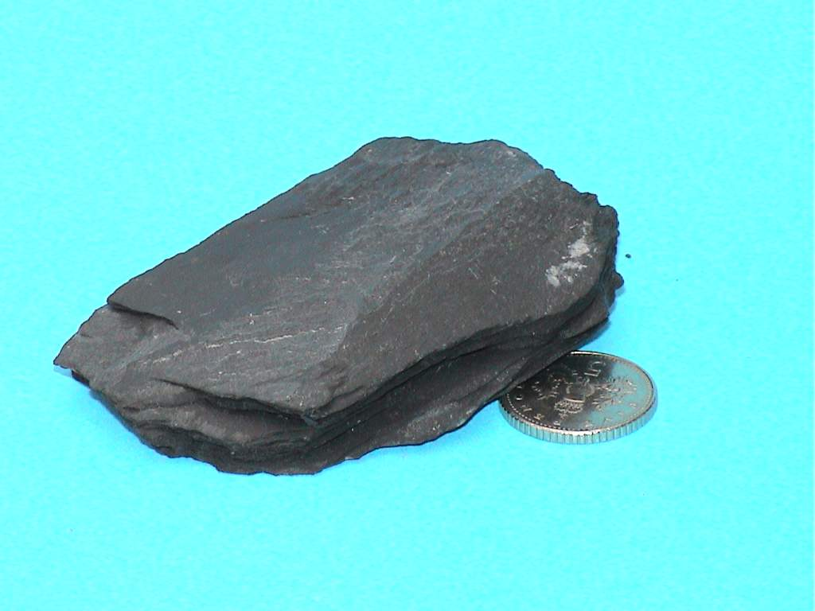
Slate – Low Grade Regional Metamorphism
Formed at depths of 5 – 15 km and temperatures of 250 – 350 C
P Max
Texture is Slaty Cleavage microscopic alignment of long axes of mica and chlorite crystals
Very fine grained - crystals much less than 1mm in diameter
Formed from argillaceous parent mudstone/shale/clay
P Max
Foliation Direction
Mineralogy: Biotite Mica, Muscovite Mica and Chlorite
May show evidence of former sedimentary structures such as bedding/laminations/fossils

Slide 66
Medium Grade – Schist 1
Formed under higher temperatures 400 to 500 degrees centigrade and at depths of 15 to 25 km
Higher temperature results in coarser crystal size
1 – 2mm and the growth of new minerals such as staurolite and garnet along with quartz and micas
Garnet crystals occur as porphyroblasts up to 5mm in diameter and often distort the foliation.

Slide 67
Medium Grade – Schist 2
Overall texture is schistose, produced by long axes of micas aligned parallel and at right angles to the direction of principal stress
Older sedimentary structures such as bedding, laminations and fossils are completely destroyed

Slide 68
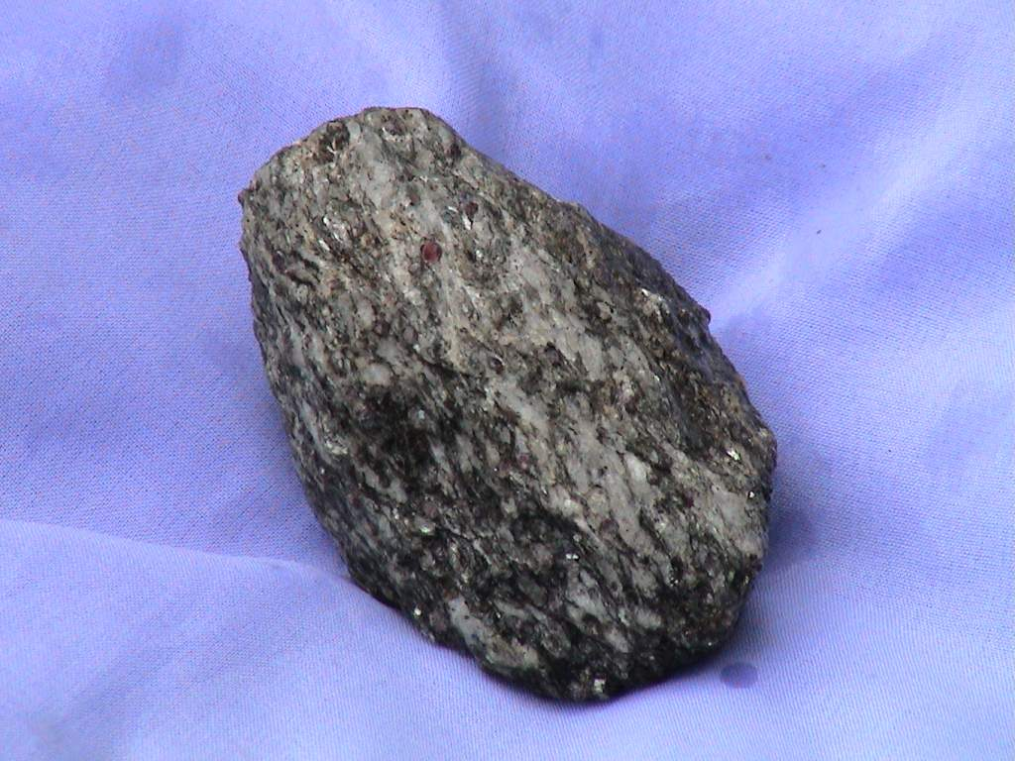
Garnet-Mica Schist – Medium Grade Regional Metamorphism
Formed from argillaceous parent clay/ mudstone/shale
P Max
Foliation – Schistose Texture. Long axes of crystals aligned parallel
Forms at 10 – 25km Depth and Temperatures of 400 - 500 C
P Max
Garnet porphyroblast 2mm in Diameter
Foliation Direction
Mineralogy: Quartz, Biotite Mica, Muscovite Mica and Garnet
2cm

Slide 69
High Grade – Gneiss 1
Formed under still higher temperatures and pressures, typically 450 to 650 degrees centigrade and at depths of 25 to 40 km
Higher temperatures result in a coarser crystal size, typically >2 mm
New minerals include kyanite and sillimanite along with quartz, feldspar and micas

Slide 70
High Grade – Gneiss 2
Minerals have segregated into mineral-rich layers or bands and the texture is referred to as gneissose banding
Mineral rich layers are parallel and aligned at right angles to the principal stress direction
Overall mineral composition is now very similar to granite

Slide 71
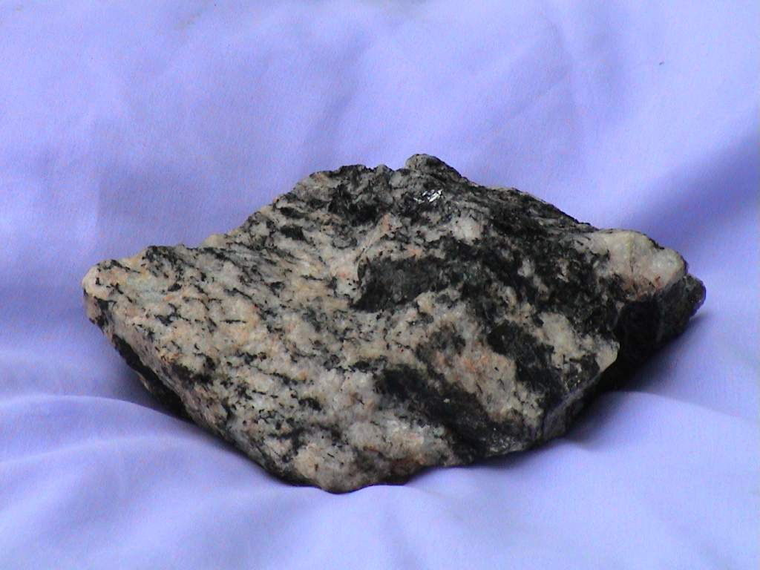
Gneiss – High Grade Regional Metamorphism
Texture Gneissose Banding Minerals segregated into mineral rich layers
3 cm
Coarse grained – crystals over 2mm in diameter
Formed from argillaceous parent mudstone/shale/clay-
P Max
P Max
Foliation Direction
Formed at depths of 20 to 35 km and temperatures between 550 and 650 C
Mineralogy: Quartz, Feldspar, Biotite Mica, Kyanite and Sillimanite

Slide 72
Very High Grade – Migmatite 1
Migmatite means literally ‘mixed rock’ and comprises two distinct components. The rock is half metamorphic and half igneous
A foliated gneissose or schistose component and a non-foliated crystalline granitic component.
The junction between the two components is indistinct or gradational.

Slide 73
Very High Grade – Migmatite 2
Field evidence suggests that the granitic component has been derived by the melting of the gneissose/schistose component
Further melting would yield a granitic or acid magma and would then constitute the igneous phase of the rock cycle

Slide 74
Regional metamorphism
is a type of metamorphism which occurs over an area of wide extent, that is, affecting a large rock volume, and is associated with large-scale tectonic processes, such as ocean-floor spreading, crustal thickening related to plate collision, deep basin subsidence, etc.
Local metamorphism
is a type of metamorphism of limited areal (volume) extent in which the metamorphism may be directly attributed to a localised cause, such as a magmatic intrusion, faulting or meteorite impact.

Slide 75
Orogenic metamorphism
is a type of metamorphism of regional extent related to the development of orogenic belts. The metamorphism may be associated with various phases of orogenic development and involve both compressional and extensional regimes. Dynamic and thermal effects are combined in varying proportions and timescales and a wide range of P-T conditions may occur.
Burial metamorphism is a type of metamorphism, mostly of regional extent, which affects rocks deeply buried under a sedimentary-volcanic pile and is typically not associated with deformation or magmatism. The resultant rocks are partially or completely recrystallized and generally lack schistosity. It commonly involves from very low to medium metamorphic temperatures and low to medium P/T ratios.

Slide 76
Ocean-floor metamorphism is a type of metamorphism of regional or local extent related to the steep geothermal gradient occurring near spreading centers in oceanic environments. The recrystallisation, which is mostly incomplete, encompasses a wide range of temperatures. The metamorphism is associated with circulating hot aqueous fluids (with related metasomatism) and typically shows an increasing temperature of metamorphism with depth.
Dislocation metamorphism is a type of metamorphism of local extent, associated with fault zones or shear zones. Grain size reduction typically occurs in the rocks, and a range of rocks
commonly referred to as mylonites and cataclasites is formed.

Slide 77
Impact metamorphism
is a type of metamorphism of local extent caused by the passage of a
shock wave due to the impact of a planetary body (projectile or impactor) on a planetary surface (target). It includes melting and vaporisation of the target rock(s).

Slide 78
Contact metamorphism is a type of metamorphism of local extent that affects the country rocks around magma bodies emplaced in a variety of environments from volcanic to upper mantle depths, in both continental and oceanic settings. It is essentially caused by the heat transfer from the intruded magma body into the country rocks. The range of metamorphic temperatures may be very wide. It may or may not be accompanied by significant deformation depending upon the dynamics of the intrusion.
Pyrometamorphism is a type of contact metamorphism characterised by very high temperatures, at very low pressures, generated by a volcanic or subvolcanic body. It is most typically developed in xenoliths enclosed in such bodies. Pyrometamorphism may be accompanied by various degrees of partial melting (to form, for example, fritted rocks, buchites).

Slide 79
Hydrothermal metamorphism is a type of metamorphism of local extent caused by hot H2O rich fluids. It is typically of local extent in that it may be related to a specific setting or cause (e.g. where an igneous intrusion mobilises H2O in the surrounding rocks). However, in a setting where igneous intrusion is repetitive (e.g. in ocean-floor spreading centres) the repetitive operation of circulating hot H2O fluids may give rise to regional effects as in some cases of ocean-floor metamorphism.
Metasomatism is commonly associated with this type of metamorphism.
Hot-slab metamorphism is a type of metamorphism of local extent occurring beneath an emplaced hot tectonic body. The thermal gradient is inverted and usually steep.

Slide 80
Combustion metamorphism is a type of metamorphism of local extent produced by the spontaneous combustion of naturally occurring substances such as bituminous rocks, coal or oil.
Lightning metamorphism is a type of metamorphism of local extent that is due to a strike of lightning. The resulting rock is commonly a fulgurite, an almost entirely glassy rock.

Slide 81
Polymetamorphism is a metamorphism resulting from more than one metamorphic event . In these definitions a metamorphic event refers to a coherent sequence of metamorphic conditions (temperature, pressure, deformation) under which metamorphic reconstitution commences and continues until it eventually ceases. Typically a metamorphic event will involve a cycle of heating and cooling, which in orogenic metamorphism will be accompanied by pressure and deformation variations

Slide 82
The term metamorphic grade is widely used to indicate relative conditions of metamorphism, but it is used variably. Within a given metamorphic area, the terms lower and higher grade have been used to indicate the relative intensity of metamorphism, as related to either increasing temperature or increasing pressure conditions of metamorphism or often both. Unfortunately this may give rise to ambiguity, about whether grade refers to relative temperature or pressure, or some combination of temperature and pressure. To avoid this it is recommended that metamorphic grade should refer only to temperature of metamorphism.
Depending on whether metamorphism is accompanied by increasing or decreasing temperature two types can be distinguished.
Prograde (= progressive) metamorphism is a metamorphism giving rise to the formation of minerals which are typical of a higher grade (i.e. higher temperature) than the former phase assemblage.
Retrograde (= retrogressive) metamorphism is a metamorphism giving rise to the formation of minerals which are typical of a lower grade (i.e. lower temperature) than the former phase assemblage.

Slide 83
DETERMINATION OF PROTOLITH
Six Common Types:
1. Pelitic (shale, mudstone)
2. Quartzo-feldspathic (sandstone, rhyolite, granite, chert)
3. Calcareous (limestone, dolomite, marls)
4. Basic (basalt, andesite, gabbro, diorite)
5. Magnesian (peridotite, serpentine)
6. Ferruginous (ironstone)

Slide 85
1. Pelitic Protoliths = Rocks enriched in clay minerals
• High Al2O3, K2O, lesser amounts Ca
• Micas favored because of Al content
• Also aluminosilicates: Al₂SiO₅ - sillimanite, andalusite, kyanite.
Kyanite: Highest density (smallest volume) forms at higher pressures.
Andalusite: Lowest density, largest volume, forms at low pressures.
Sillimanite: Intermediate density, volume; forms at moderate T, P.
Alumino-silicate triple point = 5.5 kb at 600oC
Wet granite solidus: Shows where anatexis occurs in sillimanite zone.
Staurolite (2*Al2O5*Fe(OH)2) = Common metamorphic mineral
Need an Al and Fe-rich protolith

Slide 86
2. Quartzo-feldspathic Protoliths: High SiO2, low Fe and Mg
• “Psammitic” is a general term for sandstone
• Quartz-rich sandstones with varying % feldspars (“arkose”)
• Felsic igneous rocks (rhyolites, tuffs, granites)
• If protolith >50% quartz then probably a sandstone or chert.
• Gneiss: Fine-grained at low grade, coarser with increasing grade.

Slide 87
3. Calcareous Protoliths: High CaO, CO₂
• Limestones and dolomite form MARBLES
• Impure limestones (with clay, silt) form Calc-silicates:
[tremolite, diopside, wollastonite, forsterite, epidote, et cetera]

Slide 88
4. Basic Protoliths: Low SiO₂ moderate CaO, MgO, FeO
• Basalts, andesites, gabbros - mafic igneous rocks.
• Some shale-limestone mixtures.
• Minerals depend on grade: chlorite, actinolite, hornblende, plagioclase, epidote, garnet.
5. Magnesian Protoliths: Very low SiO₂, high MgO
• Peridotites >> serpentine, magnesite.
• Serpentine (low T) >> antigorite (high T serpentine), olivine.
6. Ferruginous Protoliths: High Fe₂O₃
• Ironstones = Precambrian iron formations (Fe-rich cherts).
•

Slide 89
A Classification of Metamorphic Rocks
Like other rocks, metamorphic rocks are classified on the basis of texture and composition (either mineralogical or chemical). Although we may consider deriving a proper name for a rock as, much better served by considering a good name as a concise way of imparting information about a rock.

Slide 90
Rocks that are only slightly metamorphosed and dominated by the original igneous or sedimentary textures are typically named for the protolith with the prefix “meta-” (e.g., meta-siltstone, meta-basalt).
In the simplest and most general sense, for a more clearly metamorphosed rock, we approach naming it by first deciding if it is a high-strain rock or not.

Slide 91
The decision may require thin section and/or field relationships to help us decide.
High-strain rocks have their own classification scheme.
If a rock is not high strain, we must next observe whether the rock is foliated/lineated.
If the rock is not high strain but is foliated, we determine the nature of the foliation and call the rock a slate, phyllite, schist, or gneiss.
If the rock is non-foliated, we call it a granofels (or hornfels)

Slide 92
1. FOLIATED ROCKS
In general, foliations in non-high-strain rocks are caused by orogeny and regional metamorphism, and the type of foliation varies with metamorphic grade. In order of increasing grade, they are:
Cleavage. Traditionally: the property of a rock to split along a regular set of subparallel, closely spaced planes.
A more general concept adopted by some geologists is to consider cleavage to be any type of foliation in which the aligned platy phyllosilicates are too fine grained to see individually with the unaided eye.

Slide 93
Schistosity. A preferred orientation of inequant mineral grains or grain aggregates produced by metamorphic processes.
Aligned minerals are coarse grained enough to see with the unaided eye. The orientation is generally planar, but linear orientations are not excluded.
Gneissose structure. Either a poorly developed schistosity or segregation into layers by metamorphic processes.
Gneissose rocks are generally coarse grained.

Slide 94
The rock names that follow from these textures are given
below. Again, these names are listed in a sequence that generally corresponds with increasing grade:
Slate. Figure a. A compact, very fine-grained, metamorphic rock with a well-developed cleavage. Freshly cleaved surfaces are dull. Slates look like shales, but have a more ceramic ring when struck with a hammer.
Phyllite. Figure b. A rock with a schistosity in which very fine phyllosilicates (sericite/phengite and/or chlorite), although rarely coarse enough to see unaided, impart a silky sheen to the foliation surface. Phyllites with both a foliation and lineation (typically crenulated fold axes) are very common.

Slide 95
Schist. Figure c. A metamorphic rock exhibiting a schistosity. By this definition, schist is a broad term, and slates and phyllites are also types of schists. The more specific terms, however, are preferable. In common usage, schists are restricted to those metamorphic rocks in which the foliated minerals are coarse enough to see easily in hand specimen.

Slide 96
Gneiss. Figure d. A metamorphic rock displaying gneissose structure. Gneisses are typically layered (also called banded), generally with alternating felsic and darker mineral layers.
Gneisses may also be lineated, but must also show segregations of felsic-mineral-rich and dark-mineral-rich concentrations.
Gneissic layers or concentrations need not be laterally continuous.

Slide 97
NON-FOLIATED ROCKS
This category is simpler than the previous one.
Again, this discussion and classification applies only to rocks that are not produced by high-strain metamorphism. A comprehensive term for any isotropic rock (a rock with no preferred orientation) is a granofels. Granofels(ic) texture is then a texture characterized by a lack of preferred orientation.
An outdated alternative is granulite, but this term is now used to denote very high-grade rocks (whether foliated or not) and is not endorsed here as a synonym for granofels.
A hornfels is a type of granofels that is typically very fine grained and compact, and it occurs in contact aureoles.

Slide 98
SPECIFIC METAMORPHIC ROCK TYPES
Marble. A metamorphic rock composed predominantly of calcite or dolomite. The protolith is typically limestone or dolostone.
Quartzite. A metamorphic rock composed predominantly of quartz. The protolith is typically sandstone.
Greenschist/greenstone. A low-grade metamorphic rock that typically contains chlorite, actinolite, epidote, and albite. Note that the first three minerals are green, which imparts the color to the rock. Such a rock is called greenschist if foliated and greenstone if not. The protolith is either a mafic igneous rock or graywacke.

Slide 99
Amphibolite. A metamorphic rock dominated by hornblende plagioclase. Amphibolites may be foliated (gneissose) or non-foliated. The protolith is either a mafic igneous rock or graywacke.
Serpentinite. An ultramafic rock metamorphosed at low grade, so that it contains mostly serpentine.
Blueschist. A blue-amphibole-bearing metamorphosed mafic igneous rock or mafic graywacke. This term is so commonly applied to such rocks that it is even applied to non-schistose rocks. Glaucophane is the most common blue amphibole, and glaucophane schist has been commonly applied to rocks known to contain it.
Eclogite. A green and red metamorphic rock that contains clinopyroxene and garnet (omphacite pyrope). The protolith is typically basaltic. Eclogites contain no plagioclase.

Slide 100
Calc-silicate rock (granofels or schist). A rock composed of various Ca-Mg-Fe-Al silicate minerals, such as grossular, epidote, tremolite, vesuvianite, etc. The protolith is typically a limestone or dolostone with silica either originally present as clastic grains or introduced metasomatically.
Skarn. A calc-silicate rock formed by contact metamorphism and silica metasomatism from a pluton into an adjacent carbonate rock.

Slide 101
Granulite. A high-grade rock of pelitic, mafic, or quartzo-feldspathic parentage that is predominantly composed of OH-free minerals. Muscovite is absent, and plagioclase and orthopyroxene are common.
Migmatite. A composite silicate rock that is heterogeneous on the scale, commonly having a dark gneissic matrix (melanosome) and lighter felsic portions (leucosome). Migmatites may appear layered, or the leucosomes may occur as pods or form a network of cross-cutting veins.

Slide 102
HIGH-STRAIN ROCKS

Slide 103
METAMORPHISM
Metamorphic grade:
a general increase in degree of metamorphism without specifying the exact relationship between temperature and pressure

Slide 104
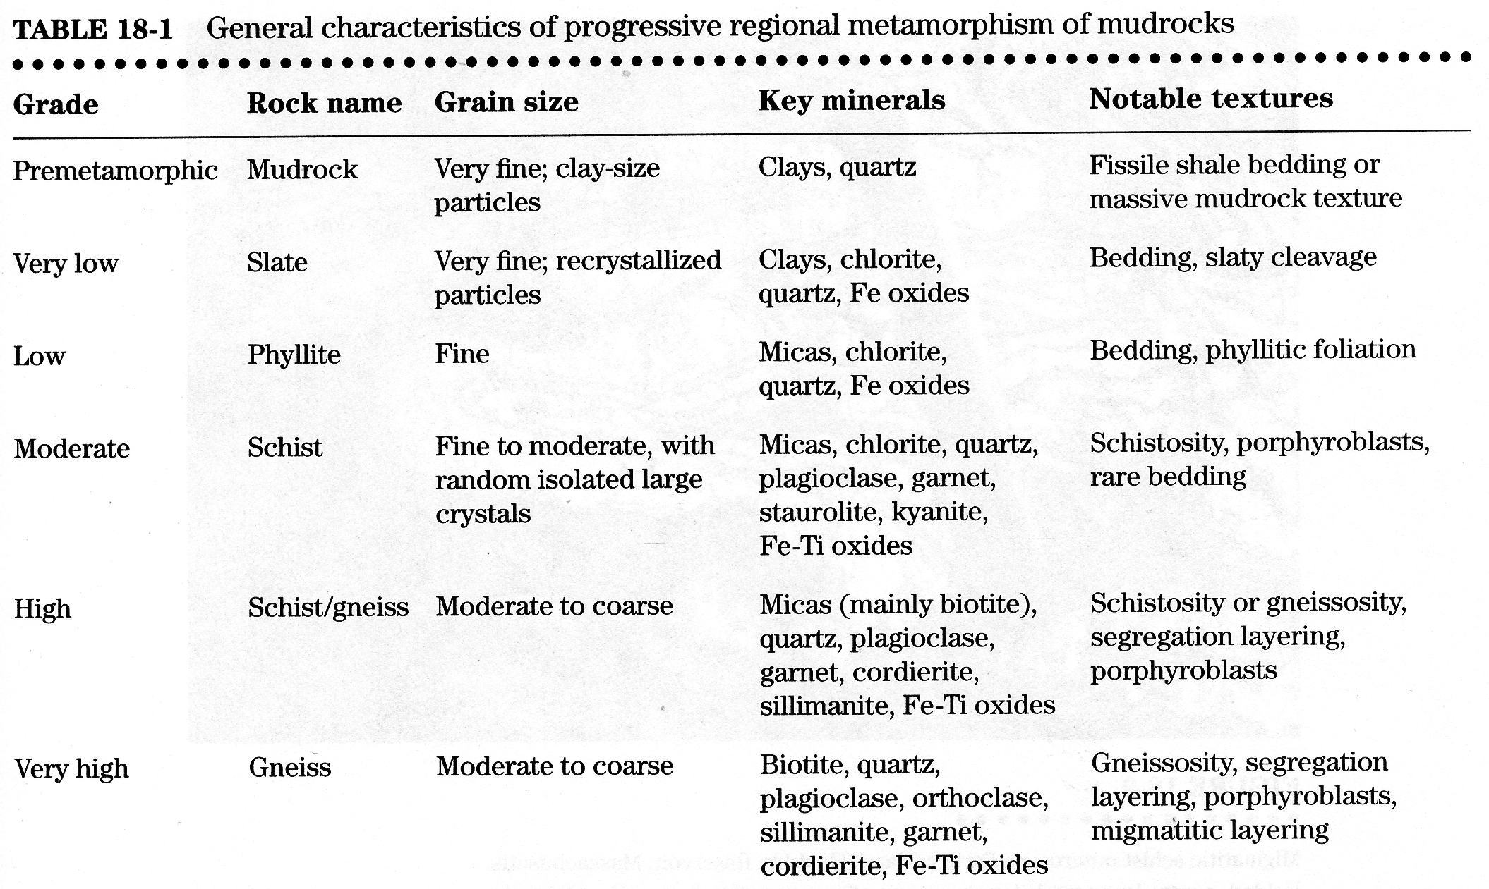
METAMORPHISM

Slide 105
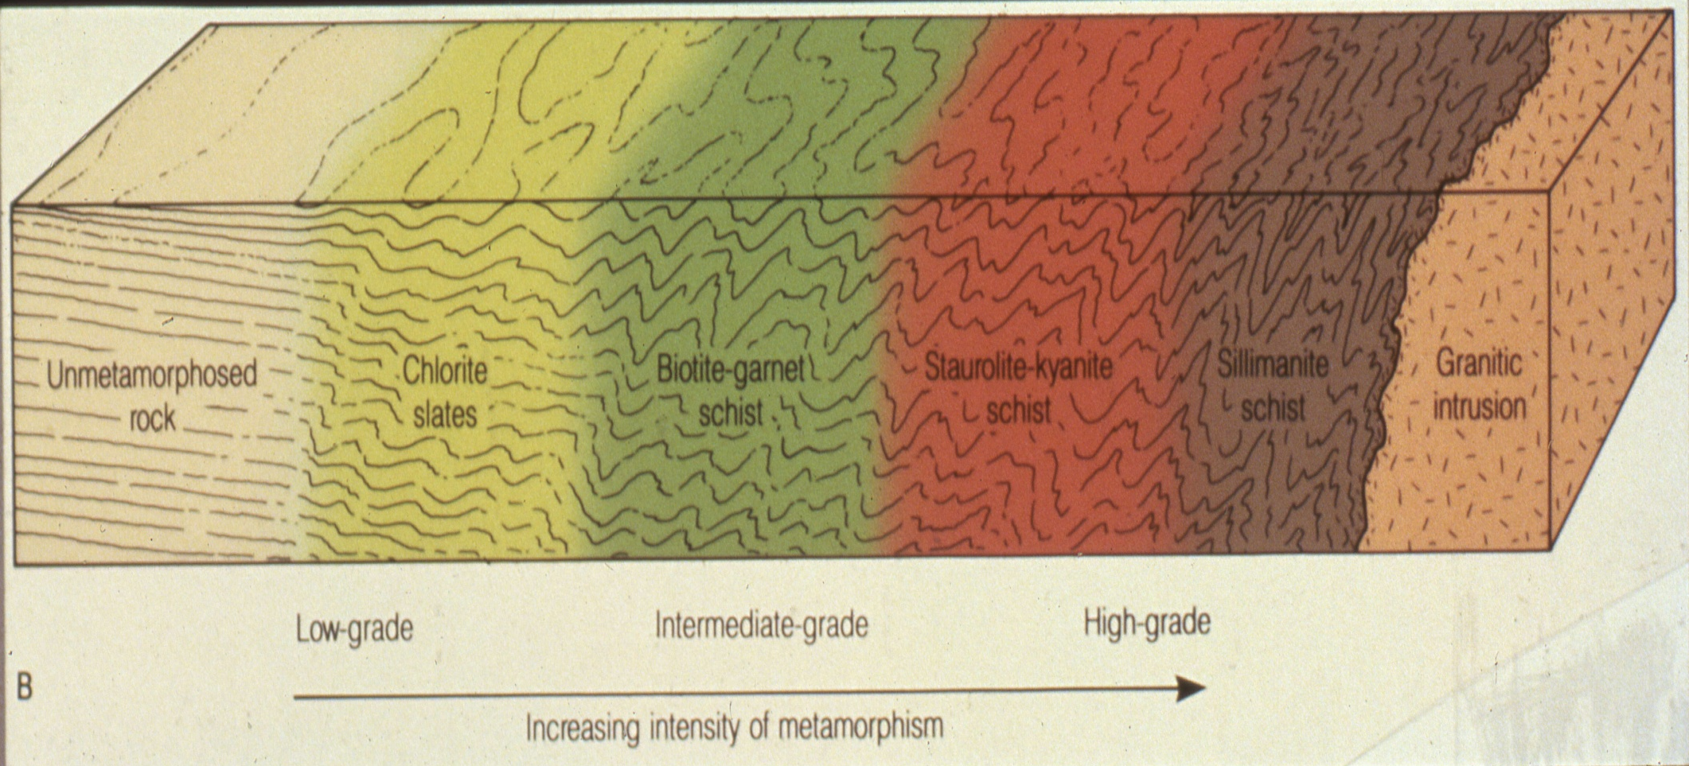
METAMORPHISM

Slide 106
Review: Types of Protolith
    1.Pelitic/mudrocks - high Al, K, Si
    2. Quartzo-feldspathic - high Si, Na, K, Al
    3. Calcareous- high Ca, Mg, CO₂
    4. Mafic- high Ca, Mg, Fe
    5. Ultramafic- very high Mg, Fe, low Si, Al
    WHY IS CHEMICAL COMPOSITION OF PROTOLITH IMPORTANT?
Notes:
Chemistry of the protolith is the most important clue toward deducing the parent rock
1. Ultramafic rocks. Mantle rocks, komatiites, or cumulates
2. Mafic rocks. Basalts or gabbros, some graywackes
3. Shales (or pelitic rocks). Fine grained clastic clays and silts deposited in stable platforms or offshore wedges.
4. Carbonates. Mostly sedimentary limestones and dolostones. Impure carbonates (marls) may contain sand or shale components
5. Quartz rocks. Cherts are oceanic, and sands are moderately high energy continental clastics. Nearly pure SiO₂.
6. Quartzo-feldspathic rocks. Arkose or granitoid and rhyolitic rocks. High Si, Na, K, Al
Categories are often gradational, and cannot include the full range of possible parental rocks
One common gradational rock type is a sand-shale mixture:psammite
Other rocks: evaporites, ironstones, manganese sediments, phosphates, laterites, alkaline igneous rocks, coal, and ore bodies

Slide 107
Metamorphic Grade
    Refers to maximum T or P of metamorphism
    What grades have we talked about?
    The idea of grade is general. We can better express the maximum P, T constraints using the concepts of metamorphic zone and facies. More on this!
Notes:
Chemistry of the protolith is the most important clue toward deducing the parent rock
1. Ultramafic rocks. Mantle rocks, komatiites, or cumulates
2. Mafic rocks. Basalts or gabbros, some graywackes
3. Shales (or pelitic rocks). Fine grained clastic clays and silts deposited in stable platforms or offshore wedges.
4. Carbonates. Mostly sedimentary limestones and dolostones. Impure carbonates (marls) may contain sand or shale components
5. Quartz rocks. Cherts are oceanic, and sands are moderately high energy continental clastics. Nearly pure SiO₂.
6. Quartzo-feldspathic rocks. Arkose or granitoid and rhyolitic rocks. High Si, Na, K, Al
Categories are often gradational, and cannot include the full range of possible parental rocks
One common gradational rock type is a sand-shale mixture:psammite
Other rocks: evaporites, ironstones, manganese sediments, phosphates, laterites, alkaline igneous rocks, coal, and ore bodies

Slide 108
METAMORPHISM
Barrow studied pelitic rocks
Barrow found:
  that he could subdivide his area into a series of metamorphic zones
  that each zone defined by the first appearance of a characteristic index mineral
  that each metamorphic zone could be mapped by a line of constant metamorphic grade, later called an isograd

Slide 109
An isograd, then, was intended to indicate a line in the field of constant metamorphic grade.
Isograd is a surface across the rock sequence, represented by a line on a map, defined by the appearance or disappearance of a mineral, a specific mineral composition or a mineral association, produced as a result of a specific reaction, for example, the “staurolite” isograd defined by the reaction:
garnet+chlorite+muscovite=staurolite+biotite+quartz+H2O.

Slide 110
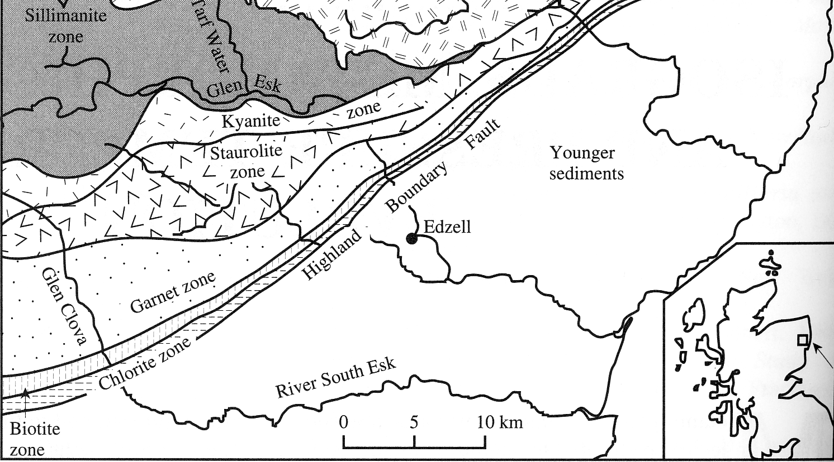
ISOGRADS: lines on a geological map showing locations of first appearance of index minerals
Increasing grade
Record of sets of P-T-X conditions in the metamorphic reaction

Slide 111
The sequence of zones now recognized, and the typical metamorphic mineral assemblage in each, are:
    Chlorite zone. Pelitic rocks are slates or phyllites and typically contain chlorite, muscovite, quartz and albite
    Biotite zone. Slates give way to phyllites and schists, with biotite, chlorite, muscovite, quartz, and albite
    Garnet zone. Schists with conspicuous red almandine garnet, usually with biotite, chlorite, muscovite, quartz, and albite or oligoclase
    Staurolite zone. Schists with staurolite, biotite, muscovite, quartz, garnet, and plagioclase. Some chlorite may persist
    Kyanite zone. Schists with kyanite, biotite, muscovite, quartz, plagioclase, and usually garnet and staurolite
    Sillimanite zone. Schists and gneisses with sillimanite, biotite, muscovite, quartz, plagioclase, garnet, and perhaps staurolite. Some kyanite may also be present (although kyanite and sillimanite are both polymorphs of Al₂SiO₅)

Slide 112
Each of these minerals is an INDEX mineral.
    Chlorite zone
    Biotite zone
    Garnet zone
    Staurolite zone
    Kyanite zone
    Sillimanite zone
    WHAT IS AN INDEX MINERAL

Slide 113
Biotite Zone
Under medium P-T the following reaction occurs at 400-450°
Chl + Kfs = Bt + Ms ( + Qtz + H₂O)
K-spar is generally consumed before all chlorite is consumed, thus it persists

Slide 114
Chloritoid
Chloritoid introduction may occur at T > 250º
Chl + Prl = Cld ( + Qtz + H₂O)
Chloritoid goes out at T = 590°
Cld = Grt + St (+Qtz +H₂O)

Slide 115
Garnet Zone
In Fe-rich rocks at ~ 525°
Fe-Chl (+ Qtz) = Alm (+ H₂O)
Under medium P-T in normal pelites the reaction occurs at ~ 610°
Chl (+Ms + Qtz) = Grt + Bt (+ H₂O)

Slide 116
Staurolite zone
Under medium P-T may appear at 570°
Cld + Ky = St + Chl (+Qtz +H₂O)
An alternate reaction occurs at 610°
Grt + Chl = St + Bt (+Qtz +H₂O)
Staurolite goes out at ~700°
St (+Ms +Qtz) = Grt +Bt +Als +H₂O

Slide 117
Kyanite Zone
Under medium P-T at ~630°
St + Chl (+Ms +Qtz) = Ky + Bt (+H₂O)
This reaction is considered the transition to the granulite facies in pelitic rocks

Slide 118
Sillimanite Zone
A polymorphic transformation occurs at ~ 690°
Ky = Sil
Sillimanite nucleates as tiny needles on micas
Muscovite goes out at ~ 790°
Ms + Qtz = Kfs + Sil + H₂O
Cordierite appears at higher temperatures
  Phl + Sil (+Qtz) = Mg-Cdr (+Kfs + H₂O)

Slide 119
Melting of Pelites
Assume all the water is due to metamorphic dehydration reactions
Muscovite decomposition causes melting, provided the pressure is high enough to retain the water
Ms + Ab + Qtz = Al₂SiO₅ + Kfs + liquid

Slide 120
ANOTHER DEFINTION:
Isograd
line that separates the zones (a line in the field of constant metamorphic grade). Also reflects the FIRST APPEARANCE of the index mineral.
Notes:
This sequence of zones now recognized in other orogenic belts, and is now so well established in the literature that the zones are often referred to as the Barrovian zones
Tilley, Kennedy, etc. confirmed Barrow’s zones, and extended them over a much larger area of the Highlands
Tilley coined the term isograd for the line that separates the zones
An isograd, then, is meant to indicate a line in the field of constant metamorphic grade
Really = the intersection of the isogradic surface with the Earth’s surface

Slide 121
To summarize:
An isograd represents the first appearance of a particular metamorphic index mineral in the field as one progresses up metamorphic grade
When one crosses an isograd, such as the biotite isograd, one enters the biotite zone
Zones thus have the same name as the isograd that forms the low-grade boundary of that zone
Because classic isograds are based on the first appearance of a mineral, and not its disappearance, an index mineral may still be stable in higher grade zones Chlorite, for example, is still stable in the biotite zone (and even up into the staurolite zone in some situations).
Notes:
Later we shall see broader categories: metamorphic facies
Barrovian zones have become the norm to which we compare all other areas of regional metamorphism
OK practice, but we shouldn’t let these zones constrain our thinking or our observations
Other zones may be important and useful locally
A chloritoid zone is prevalent in the Appalachians (X)

Slide 122
Problems with Isograds
Most rocks have complex compositions, (Mg,Fe) or (Na,Ca) substitutions
Many reactions are at least divariant
Even isograds in simple rocks are “smeared”

Slide 123
What happens to our PROTOLITH when acted on by AGENTS OF CHANGE??
Agents of Change → T, P, fluids, stress, strain
Metamorphic Reactions!!!!
  Solid-solid phase transformation
  Solid-solid net-transfer
  Dehydration
  Hydration
  Decarbonation
  Carbonation

Slide 124
Metamorphic Reactions
Univariant Reaction Lines
The grid define stability limits
  End-member minerals
  Mineral assemblages

Slide 125
Solid-solid phase transformation
Polymorphic reaction → a mineral reacts to form a polymorph of that mineral
No transfer of matter, only a rearrangment of the mineral structure
Example:
  Andalusite → Sillimanite
Al₂SiO₅
Al₂SiO₅

Slide 126
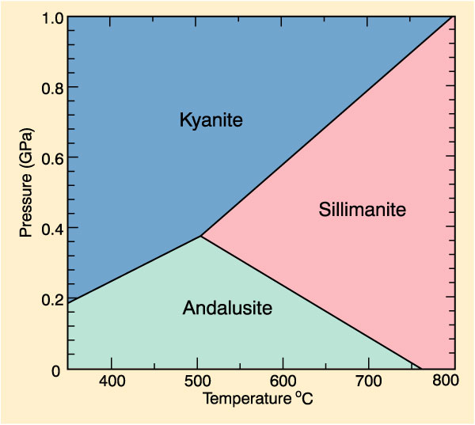
Phase Transformations: Al₂SiO₅
Isochemical
Only f(P,T)
Common in Al rich rocks (metapelites)
Rough P-T indicator:
  Andalusite suggests low P
  Kyanite = high P
  Sillimanite = high P and T
Notes:
Figure 26-15. The P-T phase diagram for the system Al₂SiO₅ showing the stability fields for the three polymorphs andalusite, kyanite, and sillimanite. Calculated using the program TWQ (Berman, 1988, 1990, 1991). Winter (2001) An Introduction to Igneous and Metamorphic Petrology. Prentice Hall.
We used the presence of andalusite to indicate low-pressure metamorphic conditions, and by referring to Fig. 21-9 we can effectively limit the pressure of andalusite-bearing rocks to values below about 0.38 GPa
The presence of two coexisting polymorphs in a single rock has often been taken to indicate that the metamorphic peak corresponded to equilibrium conditions along the univariant boundary curve separating the pair
If an independent estimate of either pressure or temperature is available, the other parameter may then be estimated from the location of the equilibrium curve
Thus if kyanite and sillimanite were to be observed together, for example, and the pressure were estimated via geobarometry to be 0.5 GPa, then the temperature of equilibration could be determined from Fig. 21-9 to be approximately 560ºC
If all three Al₂SiO₅ polymorphs were to be found in stable coexistence, the assemblage would indicate conditions at the invariant point (ca. 500ºC and 3.8 GPa)

Slide 127

Phase Transformation Reactions
Independent of other minerals present, fluids, etc.
Andalusite + Ms + Qtz + Bt +… will -> Sill at the transition grade regardless of other phases
Used presence of andalusite to indicate low-pressure metamorphic conditions, Fig. 21-9 effectively limits pressure < about 0.38 GPa
Two coexisting polymorphs in a single rock -> metamorphic peak along univariant boundary curve (if at eqm)
If independent estimate of either P or T -> other parameter may then be estimated from the equilibrium curve
Example: if kyanite and sillimanite observed together & P estimated via geobarometry = 0.5 GPa, then T ~560ºC
If all three Al₂SiO₅ polymorphs found in stable coexistence -> conditions at the invariant point (ca. 500ºC and 0.38 GPa)

Slide 128
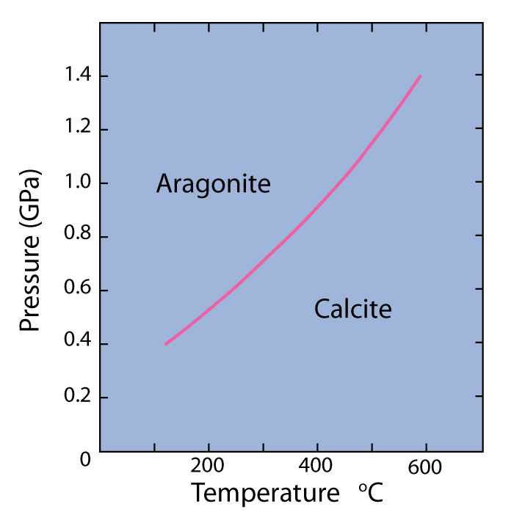
If CaCO₃ is stable, it should occur as calcite at T-P below equilibrium curve, and as aragonite at T-P above the curve
Aragonite is the stable CaCO₃ polymorph commonly found in blueschist facies terranes

Slide 129
Solid-solid net-transfer
Involve solids only
Differ from polymorphic transformations: involve solids of differing composition, and thus material must diffuse from one site to another for the reaction to proceed
Examples:
NaAlSi₂O₆ + SiO₂ = NaAlSi₃O₈
  Jd Qtz Ab
MgSiO₃ + CaAl₂Si₂O₈ = CaMgSi₂O₆ + Al₂SiO₅
  En An Di And

Slide 130
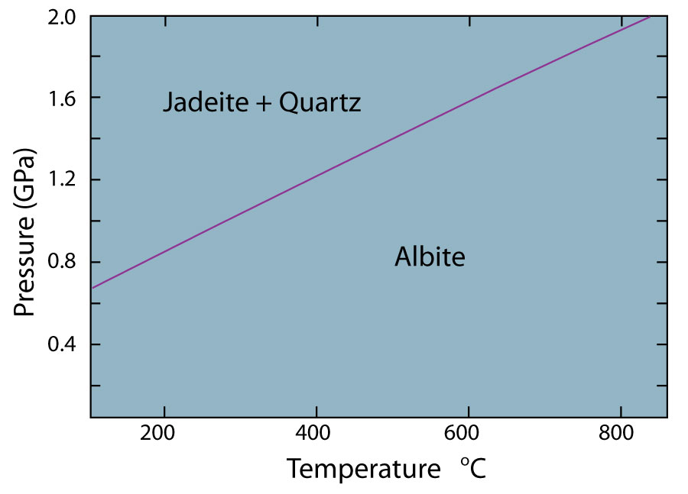
Figure 27-1. Temperature-pressure phase diagram for the reaction: Albite = Jadeite + Quartz calculated using the program TWQ of Berman (1988, 1990, 1991). Winter (2010) An Introduction to Igneous and Metamorphic Petrology. Prentice Hall.
Notes:
Reaction curves typically pretty straight
DS and DV change little
S changes more than DS(reaction)

Slide 131
Solid-Solid Net-Transfer II
If minerals contain volatiles, the volatiles must be conserved in the reaction so that no fluid phase is generated or consumed
For example, the reaction:
  Mg₃Si₄O₁₀(OH)₂ + 4 MgSiO₃ = Mg₇Si₈O₂₂(OH)₂
  Talc Enstatite Anthophyllite
  involves hydrous phases, but conserves H₂O
  It may therefore be treated as a solid-solid net-transfer reaction

Slide 132
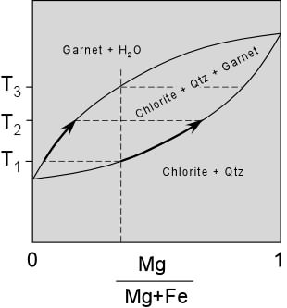
Hydration/ Dehydration Reactions
Metamorphic reactions involving the expulsion or incorporation of water (H₂O)
Example:
  Al₂Si₄O₁₀(OH)₂ <=> Al₂SiO₅ + 3SiO₂ + H₂O
  Pyrophyllite And/Ky Quartz water

Slide 133
Carbonation / Decarbonation Reactions
Reactions that involve the evolution or consumption of CO₂
CaCO₃ + SiO₂ = CaSiO₃ + CO₂
calcite quartz wollastonite
Reactions involving gas phases are also known as volatilization or devoltilization reactions
These reactions can also occur with other gases such as CH₄ (methane), H₂, H₂S, O₂, NH₄⁺ (ammonia) – but they are not as common

Slide 134
Systems
Rock made of different minerals
Metamorphic agents of change beat on it → metamorphic reactions occur
A closed system does not gain or lose material of any kind
An open system can lose stuff – liquids, gases especially

Slide 135
What is the type of this metamorphic reaction?
CaCO₃ + SiO₂ = CaSiO₃ + CO₂
What is the name of each component of this reaction?
Draw a sketch showing the relation between these components (Biotite-garnet schist; chlorite slate, un metamorphosed rocks, igneous intrusion, silliminaite schist and staurolite-kyanite schist?
Expalin the following?
An isograd
Problems with Isograds
Different reasons that lead the prograde metamorphism to be the more common than retrograde?
Metamorphic Conditions of biotite zone.
Green schist and greenstone
Using ACF ternary diagram for classification of metamorphic protoliths

Slide 136
To sum Up

Slide 137
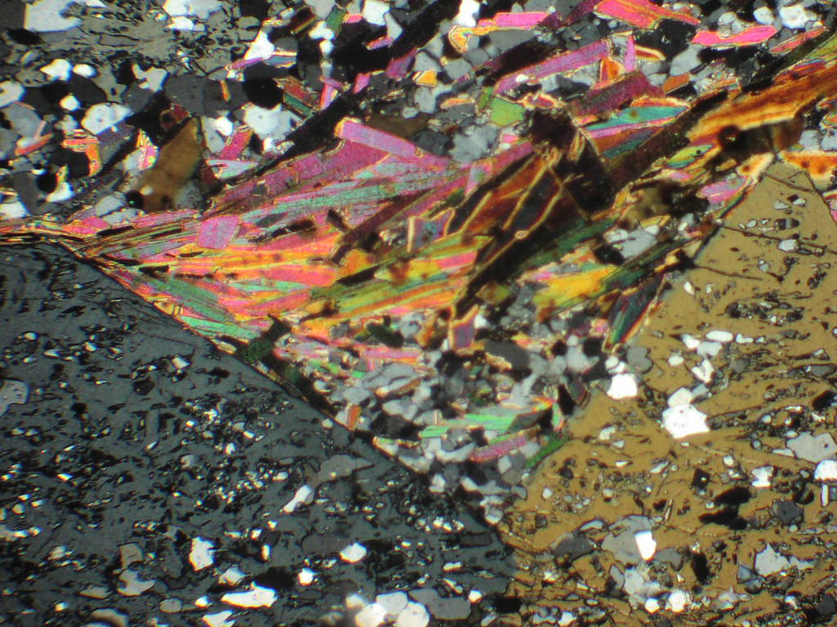
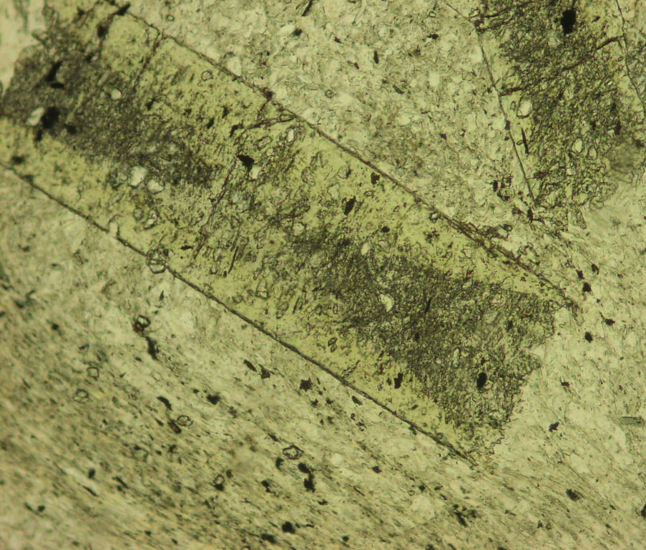
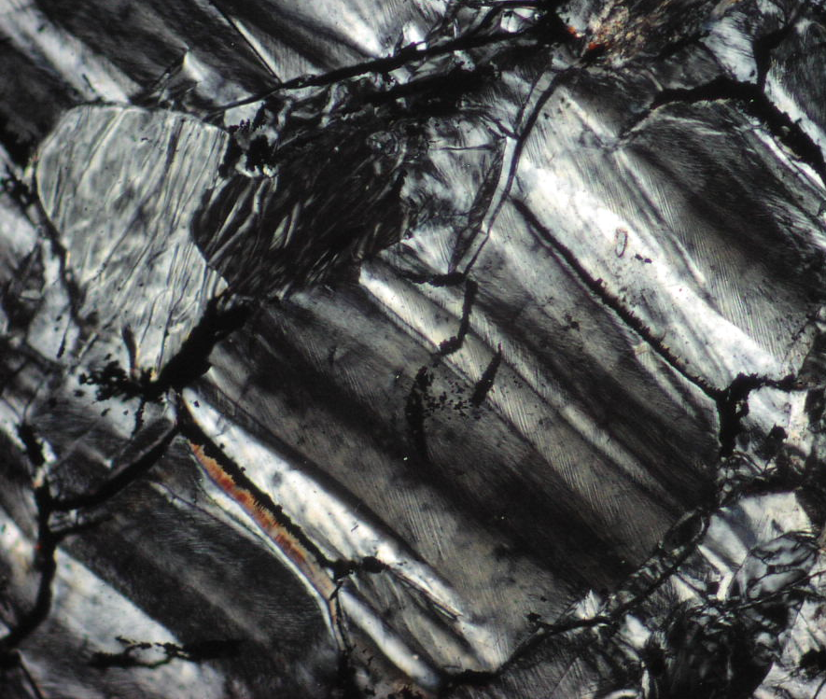
Development of Metamorphic Rocks
The yielded metamorphic rocks, with specific mineral composition and textures is a function of:
◆ Protolith nature i.e: whole rock chemistry (pelitic (Argillaceous), semipelitic, calcareous (limestone and dolomite), mafic-ultramafic, basic igneous, granitic, Mn-rich sediments, ironstone, laterites... etc.)
◆ P-T-X conditions (the intensity of temperature and the intensity and type of pressure (simple compressed or twisted and broken) influence and the presence or absence of fluids and their chemistry during metamorphism)
◆ Time (who long the rock subjected to HT and HP?. By which the grain size was evolved, and the reactions were proceed)

Slide 138
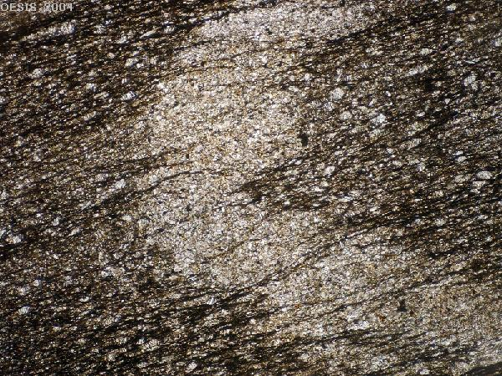
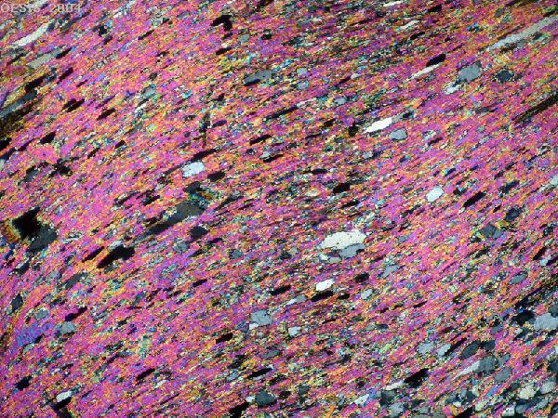
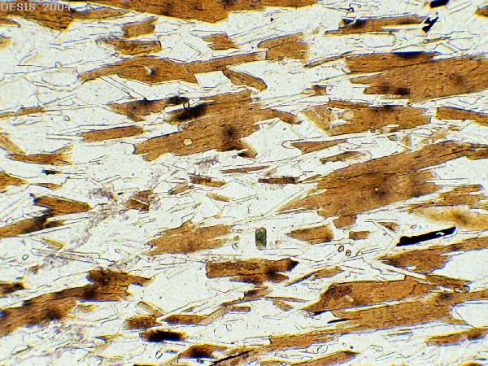
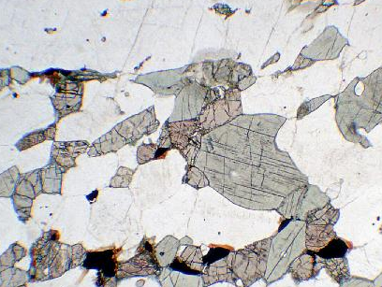

Slide 139
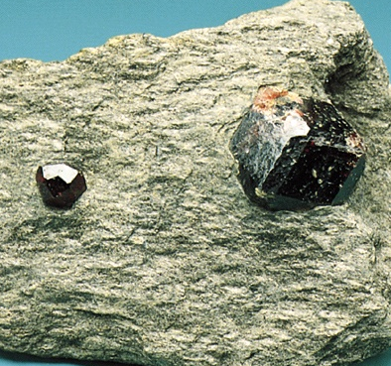
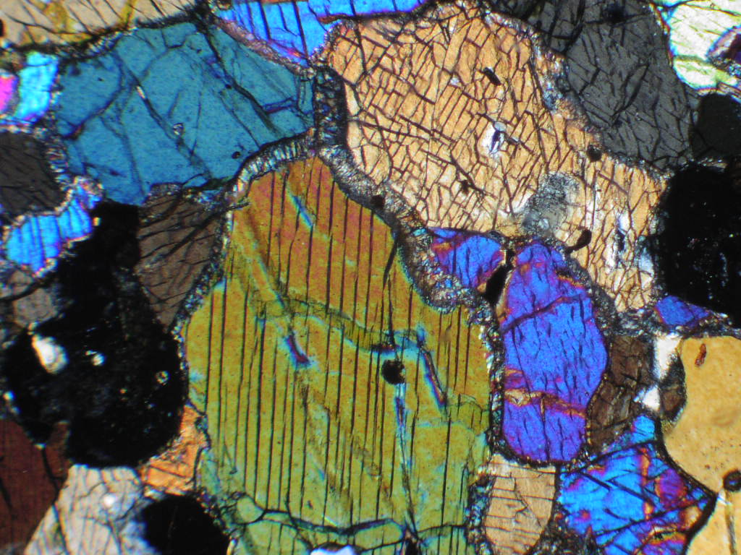
Metamorphic Rocks components and development
A metamorphic rock consists of individual grains of several solid minerals and a network of grain boundaries, which at the time of metamorphism may have held an aqueous fluid, providing pathways for transport through the rock.
garnet
Omphacite
garnet

Slide 140
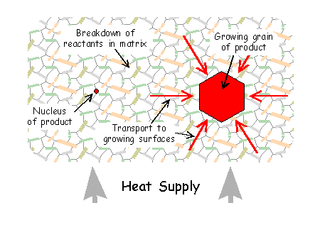
Development of Metamorphic minerals
For a new mineral to appear by a chemical reaction, a number of processes have to operate in concern:
➔ Nucleation: nuclei (embryo crystals) of the new mineral appear
➔ Interface reactions - dissolution: reactant minerals break down, their chemical constituents going into solution
➔ Interface reactions - growth: material is added onto the nuclei to build larger crystals
➔ Mass transfer: material is transported through the rock from sites of breakdown to sites of growth

Slide 141
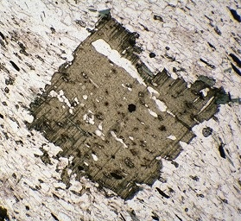
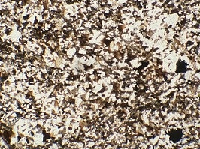
Nucleation, Mineral growth and Grain size
Completed reaction produces an amount of product (mineral phases). The microstructure, will depend on the relative rates of nucleation and growth of minerals
- Grain size in a metamorphic rocks is a function in:
Intensity of P-T conditions,
nuclation rate, and
Time interval of metamorphism
Coarse-grained rocks are the product of long sustained metamorphic conditions (possibly over millions of years) at HT and HP (e.g. in high grade regional metamorphic rocks)
Fine-grained rocks are products of LP, LT, in some cases, short reaction time (e.g. in contact metamorphiic rocks)

Slide 142
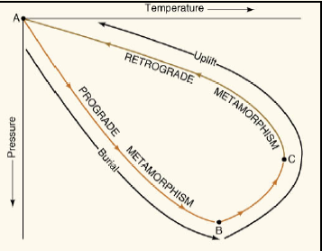
Metamorphic Reactions and P-T path
- With increasing P-T conditions, metamorphic reaction toke place (e.g. burial effect) until the maximum pressure and temperature (peak condition), then with decreasing the P-T conditions (e.g. uplift) until cooling of the rock. This is known as Metamorphic P-T path
- The P-T path include three segments:
➔ Prograde segment: With increasing the P-T conditions (such as burial effect)
➔ Peak segment: at maximum P-T conditions (at the summit metamorphic conditions)
➔ Retrograde segment: With decreasing P-T conditions (such as uplift)
- The metamorphic P-T can be simple (clockwise or anticlockwise) or complex due to multiphase metamorphism

Slide 143
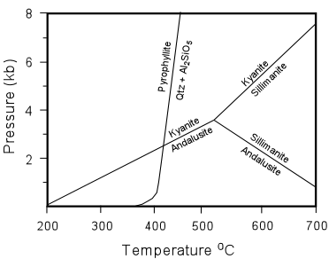
Types of Metamorphic reactions
- With either progressing or retrogressing metamorphism, various types of metamorphic reactions are proceeds e.g.:
1- Univarient reactions: reactions that plot as line or curve on the P-T diagram and depend on temperature and pressure only e.g:
Al₂Si₄O₁₀(OH)₂ → Al₂SiO₅ + 3 SiO₂ + H₂O
Pyrophyllite Al-silicate + Qtz + fluid

Slide 144
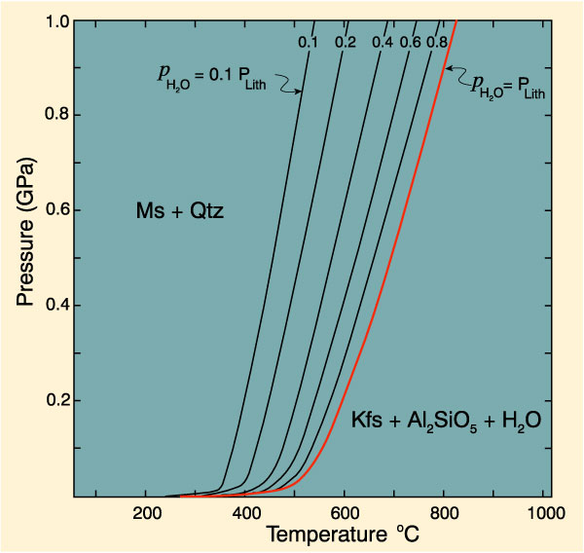
Cont. Types of Metamorphic reactions
2- Divarient reactions: reactions occur over wide range of P-T. This because most minerals involved in the reaction exhibit solid solution (e.g garnet, mica, plagioclase); therefore, the reaction boundaries can changed depend on the composition of solid solution.
KAl₂Si₃AlO₁₀(OH)₂ + SiO₂ = KAlSi₃O₈ + Al₂SiO₅ + H₂O
Ms Qtz Kfs Sill W

Slide 145
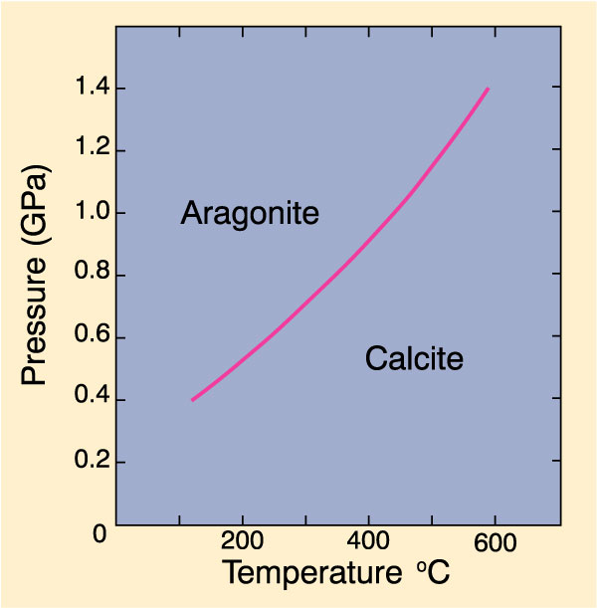
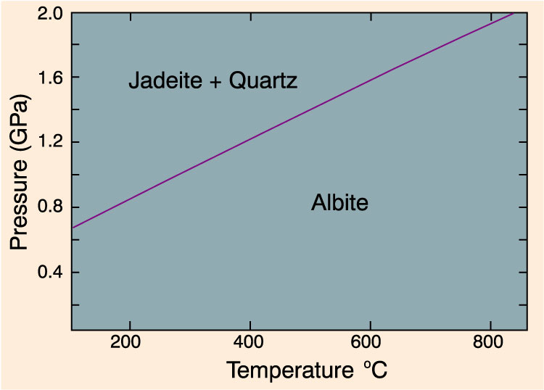
Cont. Types of Metamorphic reactions
3- Solid-soild reaction: only involve the solid-phases for both reactant and products (with no fluid phases). So reactions involves phase transformation e.g.
Calcite ↔ aragonite,
andalusite ↔ sillimanite,
graphite ↔ diamond
Albite ↔ jadite + quartz

Slide 146
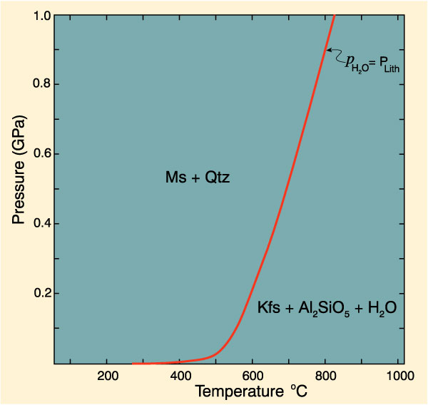
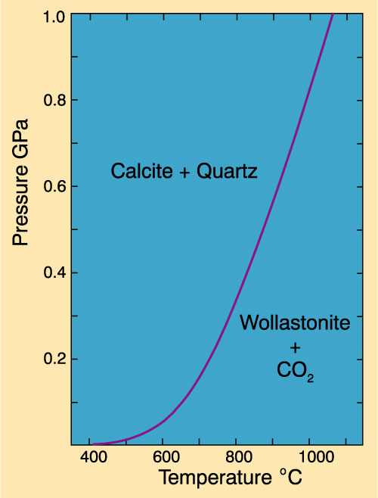
Cont. Types of Metamorphic reactions
4- Dehydration reactions: reactions that liberate H₂O. This always occur in the prograde reaction, i.e. with increasing temperature e.g
chlorite + muscovite →
orthoclase + andalusite + H₂O↑
5- Decarbonation reaction : reactions that liberate CO₂ e.g
Calcite + quartz → Wallstonite + CO₂ ↑

Slide 147
Cont. Types of Metamorphic reactions
6- Oxidation-reduction reaction: reactions that involve change the valence state of Fe-Ti oxide phases (Fe⁺² and Fe⁺³) e.g: the breakdown of biotite to K-feldspars and magnetite at high P-T conditions
biotite + O₂ → K-feldspars + Magnetite + H₂O
7- Cation exchange reaction: reaction involves ionic substitution of two or more phases in the system e.g:
Fe-garnet + Mg-biotite → Fe-biotite + Mg-garnet

Slide 148
Protoliths of metamorphic rocks
As we discuss, The yielded metamorphic rocks is function of:
  Protolith (original rock) nature  bulk-rock chemistry
  P (pressure)-T (temperature)-X (active fluids) conditions
  Time
At specific P-T-X conditions, reactions in solid state toke place in the rock and new equilibrated mineral assemblage and corresponding textures are arise, which equivalent to the influence metamorphic conditions.

Slide 149
Protoliths of metamorphic rocks
The protoliths of the metamorphic rocks could be:
Sedimentary rocks
  Shales (Pelitic rocks)
  Sandstones (Arenaceous rocks and semipelitic rocks)
  Carbonate (Calcareous rocks)
  marl rocks
- Igneous rocks
  - Basic igneous rocks (metabasites)
  - Ultramafic rocks
  - Granitoid rocks
- Prior metamorphic rocks

Slide 150
METAMORPHISM
Barrow’s mineralogical zones are typical of orogenic regional metamorphism
His sequence has been recognized in other orogenic belts around the world, and is now referred to as Barrovian zones
Has proven a good way of comparing grades of metamorphism from one area to another,
HOWEVER…
Barrow worked with meta-pelites and his mineralogy only applies to them; need something more general, hence…

Slide 151
METAMORPHISM
Eskola (1915) noted:
  worldwide occurrence of essentially identical metamorphic assemblages
  in same area, rocks of same composition have different mineralogy
  equilibrium mineralogy controlled by P-T conditions and starting composition
From these observations, Eskola developed the concept of metamorphic facies

Slide 152
METAMORPHISM
A metamorphic facies is:
“a unit, defined by its mineral assemblage, which includes all rocks, despite their chemical variety, which habitually occur in close mutual association and which have been subjected to comparable conditions of metamorphism”

Slide 153
METAMORPHISM
Facies of Contact Metamorphism
Albite-Epidote hornfels
Hornblende hornfels
Pyroxene hornfels
Sanidinite hornfels
Immature Facies of Burial or Low Grade Regional Metamorphism
5. Zeolite
Prehnite-pumpellyite
Mature Facies of Low Grade Regional Metamorphism
Lawsonite
Blueschist
Greenshist
Facies of High Grade Regional Metamorphism
Amphibolite
Granulite
Eclogite
Modified from Turner & Verhoogen (1951)

Slide 154
METAMORPHISM
The definitive mineral assemblages that characterize each facies (for mafic rocks).

Slide 155
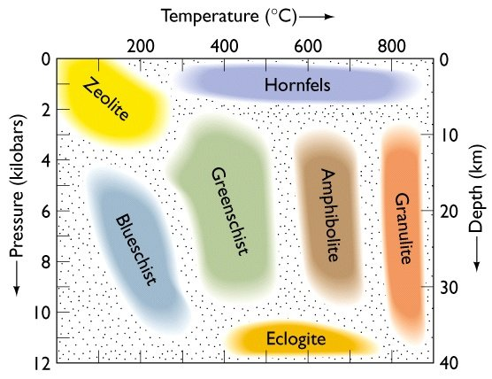
METAMORPHIC FACIES: temperature & pressure regimes
Low Pressure
High Pressure
Low temperature
High Temperature
Assemblage of metamorphic rocks formed under a similar range of pressure and temperature conditions

Slide 156
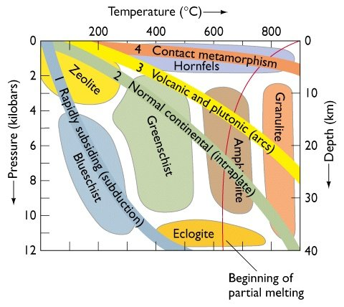
METAMORPHIC FACIES: typical settings
Intraplate: normal range
Contact: High temperature
Arc: increased temperature
Subduction zones: high pressure

Slide 157
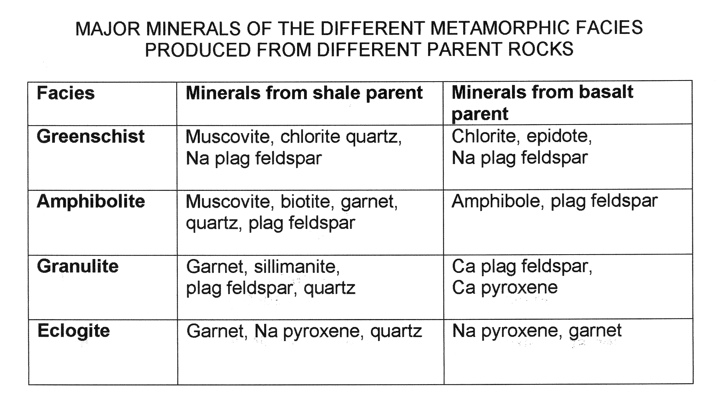
METAMORPHIC FACIES: mineral assemblages
Increasing Temperature
Original chemistry of parent rock controls the mineral assemblage formed during metamorphism

Slide 158
Metamorphic Index minerals
INDEX MINERALS are diagnostic minerals formed by metamorphic reactions
They are a function of P, T and rock & fluid compositions (X) at time of the reaction
Used to define metamorphic zones
Demonstrates progress of metamorphism
REGIONAL METAMORPHISM OF SHALES
LOW GRADE CHLORITE
BIOTITE
GARNET
STAUROLITE
KYANITE
HIGH GRADE SILLIMANITE
Index Minerals formed: controlled by original rock (X), P, and T.

Slide 159
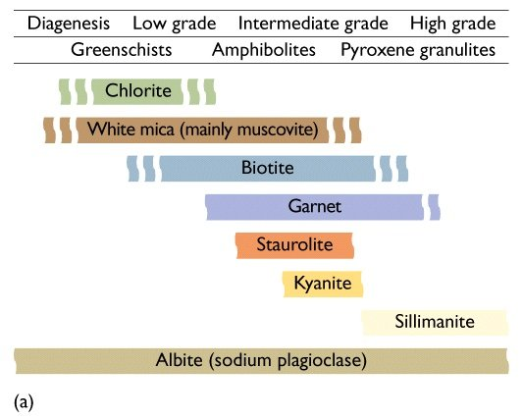
Minerals function of temperature, pressure & parent rock
Increasing Grade & relevant facies
Index minerals
REGIONAL METAMORPHISM OF SHALES

Slide 160
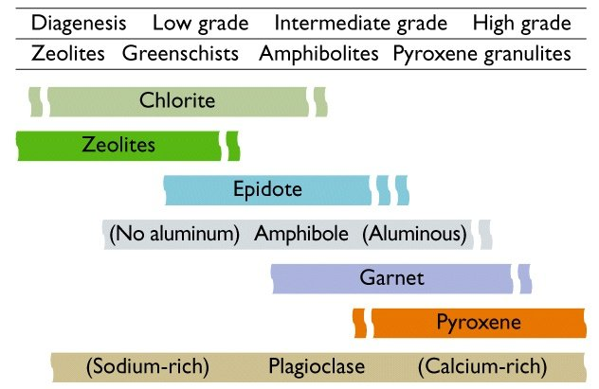
REGIONAL METAMORPHISM OF BASALTS
Increasing Grade & relevant facies
Index minerals

Slide 161
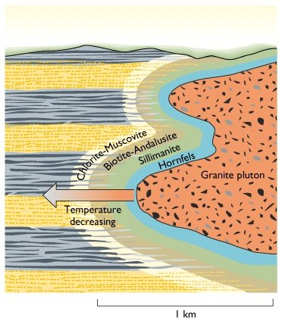
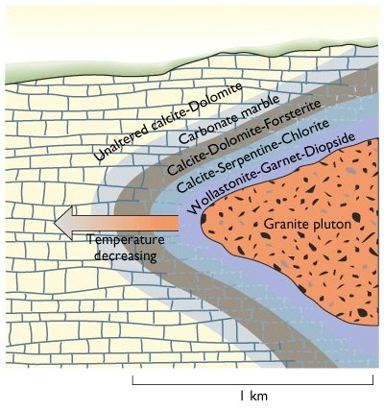
SANDSTONES & SHALES: (siliciclastic source)
CONTACT METAMORPHISM: heat alone
LIMESTONES: (carbonate source)
Minerals produced a function of temperature & parent rock

Slide 162
Facies of regional Metamorphism:
1) Greenschist Facies (includes chlorite/biotite zones of Barrow).
2) Epidote Amphibolite facies (garnet zone).
3) Amphibolite Facies (staurolite/kyanite/sillimanite zones)
4) Granulite facies
5) Eclogite facies

Slide 163
6. Zeolite Facies: Incipient metamorphism at low T and P
• Zeolites = Hydrated feldspars (mostly calcic).
• Temperatures 100-200oC.
• Index minerals = Laumonite, thompsonite, other zeolites, calcite, interlayered smectite/chlorite.
• Metabasalts: Veins and amygdule fillings
• Sandstones: Veins, interstitial pore space fillings.

Slide 164
7. Prehnite-Pumpellyite Facies (Sub-greenschist, low T, P)
• Index minerals = Prehnite, pumpellyite, calcite, chlorite, albite
• Temperatures = 150-250oC
• Metabasalts: Veins, amygdules, replacement of primary plagioclase, olivine, glass.
• Sandstones: Veins, replacement of clastic feldspars.
Prehnite is an inosilicate of calcium and aluminium with the formula: Ca₂Al(AlSi₃O₁₀)(OH)₂. Limited Fe³⁺ substitutes for aluminium in the structure. Prehnite crystallizes in the orthorhombic crystal system, and most oftens forms as stalactitic or botryoidal aggregates, with only just the crests of small crystals showing any faces, which are almost always curved or composite.

Slide 165
Pumpellyite is a group of closely related sorosilicate minerals:
pumpellyite-(Mg): Ca₂MgAl₂[(OH)₂|SiO₄|Si₂O₇]·(H₂O)^{[1]}
pumpellyite-(Fe2+): Ca₂Fe²⁺Al₂[(OH)₂|SiO₄|Si₂O₇]·(H₂O)^{[2]}
pumpellyite-(Fe3+): Ca₂(Fe³⁺,Mg,Fe²⁺)(Al,Fe³⁺)₂[(OH,O)₂|SiO₄|Si₂O₇]·H₂O^{[3]}
pumpellyite-(Mn2+): Ca₂(Mn²⁺,Mg)(Al,Mn³⁺,Fe³⁺)₂[(OH)₂|SiO₄|Si₂O₇]·(H₂O)^{[4]}
pumpellyite-(Al): Ca₂(Al,Fe²⁺,Mg)Al₂[(OH,O)₂|SiO₄|Si₂O₇]·H₂O^{[5]}
Pumpellyite crystallizes in the monoclinic-prismatic crystal system. It typically occurs as blue-green to olive green fibrous to lamellar masses.
Pumpellyite occurs as amygdaloidal and fracture fillings in basaltic and gabbroic rocks in metamorphic terranes. It is an indicator mineral of the prehnite-pumpellyite metamorphic facies. It is associated with chlorite, epidote, quartz, calcite and prehnite.

Slide 166
8. Blueschist Facies: High P at low Temperatures
• Index minerals = Glaucophane, albite, jadeite, lawsonite, aragonite.
• Temperatures = 250-350oC.
• Pressures > 6-8 kb.
• Metabasalts: Glaucophane, albite, lawsonite, sphene
• Sandstones, shales: Jadeite, albite, quartz, lawsonite, aragonite, paragonite (Na white mica)

Slide 167
FACIES – PROTOLITH—MINERAL ASSEMBLAGE TABLE:

Slide 168
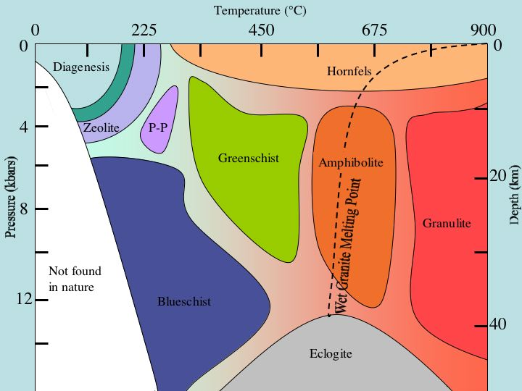

Slide 169
Metamorphic Facies Concept
Dual basis for the facies concept
Descriptive: relationship between rock composition and its mineralogy
A metamorphic facies is set of repeatedly associated metamorphic mineral assemblages
If we find specified assemblage or group of compatible assemblages covering range of compositions in the field, then a certain facies may be assigned to the area
Interpretive: range of T and P conditions represented by each facies
  Eskola was aware of T-P implications of concept and correctly deduced the relative T and P represented by different facies
  We can now assign relatively accurate T and Pe limits to individual facies

Slide 170
METAMORPHISM
Dual basis for the facies concept:
Descriptive: a way of grouping rocks of varying starting compositions together by their joint mineral assemblages
Interpretive: once a facies is defined, a range of temperature and pressure conditions is also implied

Slide 171
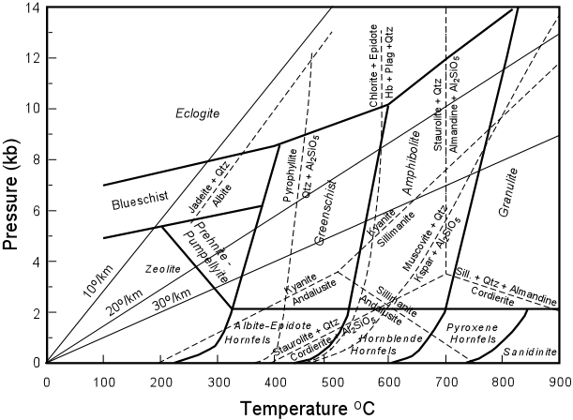
What if we had staurolite and andalusite together? What conditions would that indicate?

Slide 172
Metamorphic Facies
Table 25-1. The definitive mineral assemblages that characterize each facies (for mafic rocks).
Notes:
The definitive mineral assemblages that characterize each facies (for mafic rocks) are listed in Table 25-1 (details and variations later)

Slide 173
Let’s put it all together…

Slide 174
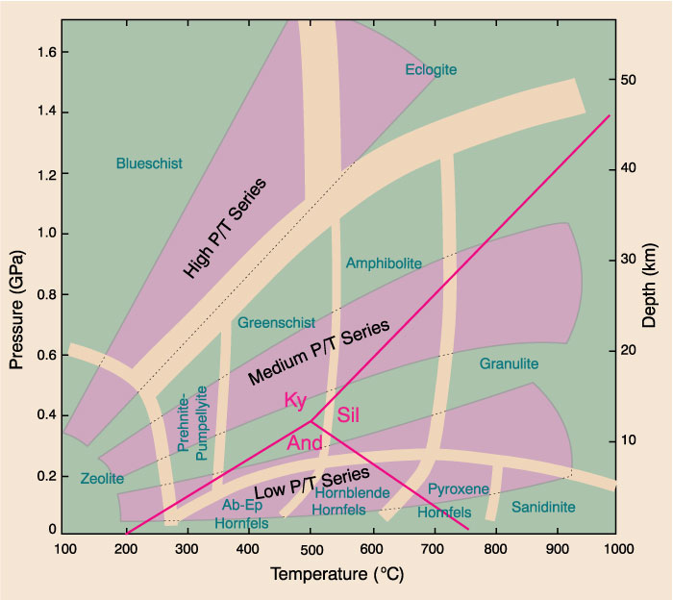
Fig. 25-3. Temperature-pressure diagram showing the three major types of metamorphic facies series proposed by Miyashiro (1973, 1994). Winter (2001) An Introduction to Igneous and Metamorphic Petrology. Prentice Hall.
Notes:
The high P/T series, for example, typically occurs in subduction zones where “normal” isotherms are depressed by the subduction of cool lithosphere faster than it can equilibrate thermally
The facies sequence here is (zeolite facies) - (prehnite-pumpellyite facies) - blueschist facies - eclogite facies.
The medium P/T series is characteristic of common orogenic belts (Barrovian type)
The sequence is (zeolite facies) - (prehnite-pumpellyite facies) - greenschist facies -amphibolite facies - (granulite facies)
Crustal melting under water-saturated conditions occurs in the upper amphibolite facies (the solidus is indicated in Fig. 25-2)
The granulite facies, therefore, occurs only in water-deficient rocks, either dehydrated lower crust, or areas with high X_{CO2} in the fluid
The low P/T series is characteristic of high-heat-flow orogenic belts (Buchan or Ryoke-Abukuma type), rift areas, or contact metamorphism
The sequence of facies may be a low-pressure version of the medium P/T series described above (but with cordierite and/or andalusite), or the sequence (zeolite facies) - albite-epidote hornfels facies - hornblende hornfels facies - pyroxene hornfels facies
Sanidinite facies rocks are rare, requiring the transport of great heat to shallow levels

Slide 175
Facies Series
Miyashiro (1961) initially proposed five facies series, most of them named for a specific representative “type locality” The series were:
    1. Contact Facies Series (very low-P)
    2. Buchan or Abukuma Facies Series (low-P regional)
    3. Barrovian Facies Series (medium-P regional)
    4. Sanbagawa Facies Series (high-P, moderate-T)
    5. Franciscan Facies Series (high-P, low T)
Notes:
The contrast between Miyashiro’s higher-T-lower-P Ryoke-Abukuma belt (Section 21.6.3) and the classical Barrovian sequence also led him to suggest that more than one type of facies series is probable
Metamorphic field gradients are highly variable (even in the same orogenic belt) and transitional series abound
Miyashiro later chose to limit the number instead to the three broad major types of facies series (also called “baric types”) illustrated in Fig. 25-3
Although the boundaries and gaps between them are somewhat artificial, the three series represent common types of tectonic environments

Slide 176
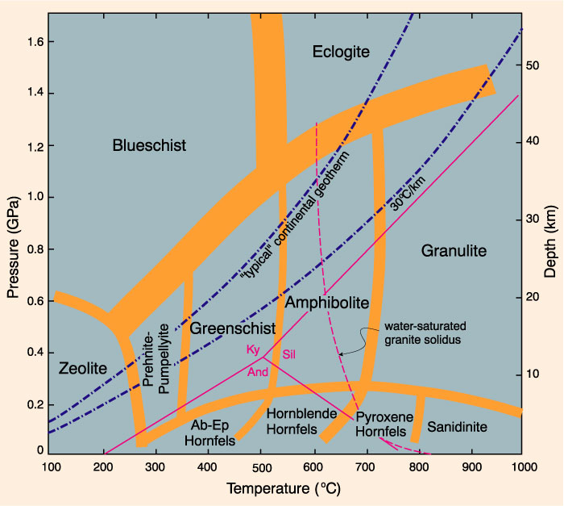
Metamorphic Facies Concept
Metamorphic series
Miyashiro (1961) initially proposed five facies series, most of them named for a specific representative "type locality" The series were:
Contact Facies Series (very low-P)
Buchan or Abukuma Facies Series (low-P regional)
Barrovian Facies Series (medium-P regional)
Sanbagawa Facies Series (high-P, moderate-T)
Franciscan Facies Series (high-P, low T)
Image: Winter (2001)
Barrovian
Franciscan
Buchan
Abukama

Slide 177
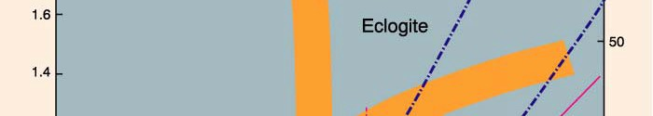




Metamorphic Facies Concept
Defined on the basis of mineral assemblages that develop in mafic rocks
Eskola (1920) proposed 5 original facies:
Greenschist
Amphibolite
Hornfels
Sanidinite
Eclogite
Eskola (1939) added
Granulite
Epidote-amphibolite
Blueschist
Later additions
Zeolite
Prehnite-pumpellyite
Albite-epidote hornfels
Hornblende hornfels
Image: Winter (2001)

Slide 178





Metamorphic Facies Concept
Defined on the basis of mineral assemblages that develop in mafic rocks
IUGS-SCMR version of facies diagram
Image: IUCS-SCMR (2007)

Slide 179
Facies of low pressure
(facies of contact metamorphism)
Epidote Hornfels Facies
The rocks is away from the igneous intrusions
The condition is not enough for the growth of plagioclase and amphibole minerals in the mafic rocks
Albite + epidote + actinolite + chlorite +quartz | Metamorphic basic rocks
Muscovite + biotite + chlorite + quartz | metapelites
Calcite + dolomite + talc + quartz + epidote | Meta calcareous rocks

Slide 180
Facies of low pressure
(facies of contact metamorphism)
Hornblende Hornfels Facies
Mineral assemblages of this facies resemble of that minerals that found in the amphibolite facies but it formed under conditions of relatively low pressure ( about 4 Kbar), this facies is characterized by:
First appearance of hornblende and calcic plagioclase (An₂₅₋₄₀) for basic rocks.
In metapelitic rocks chlorite is always absent but it may be found only if retrograde metamorphism occur. Also andalusite and corderite are found.
Anthophyllite mineral is the characterize mineral of this facies although this mineral is absent in the pyroxene hornfels facies.

Slide 181
Facies of low pressure
(facies of contact metamorphism)
Hornblende Hornfels Facies
Hornblende + Plagioclase ± Diopside, Anthophyllite/Cummongotnite,quartz | Metamorphic Basic Rocks
Muscovite + Biotite + Andalusite + Corderite + Quartz + Plagioclase | Metapelites
Dolomite + Calcite + Tremolite ± Talc + Quartz | Meta Calcareous Rocks

Slide 182
Facies of low pressure
(facies of contact metamorphism)
Pyroxene Hornfels Facies
This facies in originate at the inner zones of the magmatic intrusions during the contact metamorphism. Mineral assemblages of this facies resemble those of the granulite facies. This facies is characterized by:
First appearance of orthopyroxenes in basic rocks.
The presence of silliminite and orthoclase and absence of muscovite although biotite is still occur.
Hornblende is not stable.
Ortho- And Clino Pyroxene + Plagioclase ± Olivine And/Or Quartz | Metamorphic Basic Rocks
Corderite + Quartz + Silliminite + Orthoclase ± Biotite | Metapelites
Calcite + Forsterite ± Diopside, Periclase Diopside + Grossularite + Wollastonite + Vesuvianite | Meta Calcareous Rocks

Slide 183
Facies of low pressure
(facies of contact metamorphism)
Sanidinite Facies
This facies is rarely found and occur under conditions of very high temperature and in direct contact with basic lavas or occur as xenoliths in Baltic lava. This facies is characterized by the presence of sanidine and relative enrichment of anorthite and wallastonite
Corderite + sanidine + tridymite Wallastonite + anorthite + diopside | Metapelites
Monticellite ± Calcite ± Diopside | Meta Calcareous Rocks

Slide 184
Facies of intermediate pressure
Zeolite and prehnite-Pumpellite Facies
This facies occur in fine grained rocks such as basalts and greywackes.
Include zeolite minerals
Perhenite + chlorite ± quartz = pumpellite + actinolite ± quartz
Heulandite + Anlcite + Quartz ± Clay Minerals | Metavolcanics And Greywackes
Muscovite + Chlorite+ Albite + Quatrz | Meta Pellitic Rocks

Slide 185
Facies of intermediate pressure
Greenschist Facies
This facies is the most common facies in the regional metamorphic rocks which is characterized by the presence of several granitic intrusions.
This facies named green according to the presence chlorite and muscovite and biotite.
The upper boundary of this facies is marked by the presence of hornblende instead of actinolite
Chlorite + albite +epidote ± actinolite ± quartz | Basic metavolcanics
Albite + quartz + epidote + Muscovite | Metagreywackes
Muscovite + chlorite + Albite + quartz | Meta pellitic rocks

Slide 186
Facies of intermediate pressure
Amphibolite Facies
This facies is equavelent to hornblende hornfels facies but with moderately pressure.
This facies is characterized by the basically occurring of amphibole and plagioclase, in addition of staurollite and garnet.
Hornblende + Plagioclase ± Epidote, Garnet, Cummingtonite, Diopside, Biotite ± Actinolite ± Quartz | Basic Rocks
Dolomite + Calcite + Tremolite ± Talc (Very Low Amphibolite Facies) | Calcereous Rocks
Muscovite + Biotite + Quartz ± Garnet Staurolite Kyanite, Silliinite | Meta Pellitic Rocks

Slide 187
Facies of high pressure
Blueschist facies Facies
Blueschist facies is a high-grade metamorphic facies typified by high pressures and associated with subduction.
Also name glaucophane –lawsonite facies. The rocks of related to this facies occur along the platetectonic boundaries where the pressure is maximum (8-6 Kbar, e. g. pacific orogenic belt and along Himalaya and Alps). These rocks are rare in the Arabo Nubian shield.
The metabasalt of the ophiolitic complexes represents good representative of this facies.
The name blue of this facies is attribute to the blue color of the glaucophane.
Glaucophane + Lawsonite ± Phengite, Omphacite | Meta Basic Rocks
Quartz + Jadite + Lawsonite ± Phengite, Galucophane | Metagrewackes
Aragonite) | Calcereous Rocks
Phengite + Paragonite + Quartz | Meta Pellitic Rocks

Slide 188
Facies of high pressure
Eclogite Facies
Eclogite is a metamorphic rock consisting of pyroxene omphacite and pyrope-rich garnet. Eclogite is a rare but geologically significant rock type. It is common in the upper mantle, especially in regions occupied by subducted oceanic plates
Eclogite is chiefly composed of red (garnet) and green (omphacite) minerals. Garnet in eclogite is usually iron-rich pyrope (contains similar amount of Mg and Fe). Omphacite is a pyroxene group mineral with a composition in the middle between jadeite and diopside. Other minerals that may occur in eclogite are quartz, kyanite, amphiboles, orthopyroxene, olivine, mica, zoisite, and rutile.lso name glaucophane –lawsonite facies.

Slide 189

ompacite (clinopyroxene) + pyrope-rich garnet +/- kyanite +/- rutile +/- quartz (low-P) +/- coesite (high-P). | Meta Basic Rocks
Quartz + Jadite/omphcite + Phengite + garnet | Granitic rocks
Aragonite | Calcereous Rocks
Pyrope-rich garnet + carpholite + phengite + chloritoid + kyanite +/- quartz (or coesite at very high P) | Meta Pellitic Rocks

Slide 190

Don`t forget

Slide 191

Don`t forget

Slide 192

Don`t forget

Slide 193
The ACF Diagram
Illustrate metamorphic mineral assemblages in mafic rocks on a simplified 3-C triangular diagram
Concentrate only on the minerals that appeared or disappeared during metamorphism, thus acting as indicators of metamorphic grade
Notes:
Eskola (1915) proposed the ACF diagram as a way to illustrate metamorphic mineral assemblages in mafic rocks on a simplified 3-C triangular diagram
He wanted to concentrate only on the minerals that appeared or disappeared during metamorphism, thus acting as indicators of metamorphic grade

Slide 194

Figure 24.4. After Ehlers and Blatt (1982). Petrology. Freeman. And Miyashiro (1994) Metamorphic Petrology. Oxford.
Notes:
Fig. 24.4 illustrates the positions of several common metamorphic minerals on the ACF diagram. Note: this diagram is presented only to show you where a number of important phases plot.
It is not specific to a P-T range and therefore is not a true compatibility diagram, and has no petrological significance

Slide 195
The ACF Diagram
By creating these three pseudo-components, Eskola reduced the number of components in mafic rocks from 8 to 3
Water is omitted under the assumption that it is perfectly mobile
Note that SiO₂ is simply ignored
  We shall see that this is equivalent to projecting from quartz
In order for a projected phase diagram to be truly valid, the phase from which it is projected must be present in the mineral assemblages represented
Notes:
Thus, to be valid, the ACF diagram must have both quartz, alkali feldspar, and plagioclase present
It may work anyway when these phases are lacking, but the result may also violate the mineralogical phase rule on occasion

Slide 196
The ACF Diagram
An example:
Anorthite CaAl₂Si₂O₈
A = 1 + 0 - 0 - 0 = 1, C = 1 - 0 = 1, and F = 0
Provisional values sum to 2, so we can normalize to 1.0 by multiplying each value by ½, resulting in
  A = 0.5
  C = 0.5
  F = 0
Where does Ab plot? Plagioclase?
Notes:
Anorthite thus plots half way between A and C on the side of the ACF triangle, as shown in Fig. 24.4

Slide 197
Figure 24.4. After Ehlers and Blatt (1982). Petrology. Freeman. And Miyashiro (1994) Metamorphic Petrology. Oxford.
Notes:
Where does K-feldspar plot??
For KAlSi₃O₈ A = 0.5 + 0 - 0.5 = 0, C = 0, and F = 0
Kspar doesn’t plot on the ACF diagram
If you try this for albite you will find that it doesn’t plot either
The ACF formula eliminates Na and K from the diagram (and thus these phases) without altering the remaining Al after the removal
All Ca-bearing plagioclase feldspars, regardless of the K and Na content, plot at the anorthite point

Slide 198






Metamorphism of Mafic Rocks
Mineral changes and associations that develop with increasing metamorphic grade
Hydrous minerals are not common in high- T igneous mafic protolith, so hydration is a prerequisite for development of metamorphic mineral assemblages that characterize most facies
Unless water is available, mafic igneous rocks will remain largely unaffected in metamorphic terranes, even as associated sediments are completely re-equilibrated
Coarse-grained intrusives are least permeable, and thus most likely to resist metamorphic changes, while tuffs and graywackes are most susceptible

Slide 199
Metamorphism of Mafic Rocks
Mineral changes and associations that develop with increasing metamorphic grade
Plagioclase
As T is lowered, the more Ca-rich plagioclases become progressively unstable
There is a general correlation between T and maximum An- content of stable plagioclase
  At low metamorphic grades only albite (An0-3) is stable
  In upper-greenschist facies oligoclase becomes stable.
  Andesine(~An40) and more calcic plagioclases are stable in upper amphibolite and granulite facies
  Excess Ca and Al released may released from calcite, an epidote mineral, titanite, or amphibole, etc., depending on P-T-X
Clinopyroxene breaks down to a number of mafic minerals, depending on grade. These include chlorite, actinolite, hornblende, epidote, a metamorphic pyroxene, etc., and the one(s) that form are commonly diagnostic of the grade and facies

Slide 200




Metamorphism of Mafic Rocks
Mafic Assemblages of the Medium P/T Series: Greenschist, Amphibolite, and Granulite Facies (most common)
Metamorphism of mafic rocks is first evident in greenschist facies (correlates with chlorite and biotite zones of associated pelitic rocks)
Typical minerals include chlorite, albite, actinolite, epidote, quartz, and possibly calcite, biotite, or stilpnomelane
Chlorite, actinolite, and epidote impart the green color from which mafic rocks and facies get their name
ACF diagram - The most characteristic mineral assemblage of the greenschist facies is: chlorite
+ albite + epidote + actinolite ± quartz
Image: Winter (2001)

Slide 201




Metamorphism of Mafic Rocks
Mafic Assemblages of the Medium P/T Series: Greenschist, Amphibolite, and Granulite Facies (most common)
Greenschist to amphibolite facies transition involves 2 major mineralogical changes
1. Transition from albite to oligoclase (increased Ca-content of stable plagioclase with T)
2. Transition from actinolite to hornblende (amphibole becomes able to accept increasing amounts of aluminum and alkalis at higher T)
Image: Winter (2001)

Slide 202




Metamorphism of Mafic Rocks
Mafic Assemblages of the Medium P/T Series: Greenschist, Amphibolite, and Granulite Facies (most common)
ACF diagram
Typically 2-phase Hbl-Plag
Most amphibolites are predominantly black rocks with up to 30% white
plagioclase
Garnet occurs in more Al- Fe-rich and Ca-poor mafic rocks and clinopyroxene in Al-poor-Ca-rich ones
Image: Winter (2001)

Slide 203
Metamorphism of Mafic Rocks
Mafic Assemblages of the Medium P/T Series: Greenschist, Amphibolite, and Granulite Facies (most common)
The transition from amphibolite to granulite facies occurs in the range 650-700ºC
In presence of aqueous fluid, associated pelitic and quartzo-feldspathic rocks (including granitoids) begin to melt in this range at low to medium pressures , so that migmatites may form and melts may become mobilized
Not all pelites and quartzo-feldspathic rocks reach granulite facies as a result
Mafic rocks generally melt at somewhat higher T
If H₂O is removed by earlier melts remaining mafic rocks may become depleted in water
Hornblende decomposes and orthopyroxene + clinopyroxene appear
This reaction occurs over a T interval of at least 50ºC

Slide 204





Metamorphism of Mafic Rocks
Mafic Assemblages of the Medium P/T Series: Greenschist, Amphibolite, and Granulite Facies (most common)
The granulite facies is characterized by the presence of a largely anhydrous mineral assemblage
In metabasites diagnostic mineral assemblage is orthopyroxene + clinopyroxene + plagioclase + quartz
Garnet is also common, and minor hornblende and/or biotite may be present
Winter (2001)

Slide 205
Metamorphism of Mafic Rocks
The origin of granulite facies rocks is complex and controversial. There is general agreement, however, on two points
Granulites represent unusually hot conditions
  T > 700ºC, geothermometry has yielded some very high T, i.e. >1000ºC
  Average geotherm T for granulite facies depths should be ~500ºC, suggesting that granulites are products of crustal thickening and excess heating
2) Granulites are dry
    These rocks didn’t melt due to lack of available H₂O
    Granulite facies terranes represent deeply buried and dehydrated roots of continental crust
    H₂O can be removed by H₂O-undersaturated melts

Slide 206





Metamorphism of Mafic Rocks Mafic Assemblages of the Medium P/T Series: Greenschist, Amphibolite, and Granulite Facies (most common)
Winter (2001)

Slide 207



Metamorphism of Mafic Rocks
Mafic Assemblages of the High P/T Series: Blueschist and Eclogite Facies
Mafic rocks (and not pelites) develop conspicuous and definitive mineral assemblages under high P/T conditions
High P/T geothermal gradients
characterize subduction zones
Mafic blueschists are recognizable by color - useful indicators of ancient subduction zones
Great density of eclogites suggests that subducted basaltic oceanic crust becomes more dense than surrounding mantle
Winter (2001)

Slide 208





Metamorphism of Mafic Rocks
Blueschist Facies - characterized in metabasites by presence of sodic blue amphibole stable only at high P (e.g. glaucophane)
Association of glaucophane
+ lawsonite is diagnostic.
Albite breaks down at high pressure by reaction to jadeitic pyroxene + quartz:
NaAlSi₃O₈ = NaAlSi₂O₆ + SiO₂
Ab = Jd + Qtz
Assemblage jadeite + quartz indicates high- pressure blueschist facies
Winter (2001)

Slide 209




Metamorphism of Mafic Rocks
Eclogite Facies - mafic assemblage omphacitic pyroxene + pyrope-grossular garnet (Christmas-tree rocks)
Along higher geothermal gradients amphibolite facies, or even the granulite facies, may lead to eclogite facies
Much of blueschist, and all of eclogite facies are marked by high-pressure instability of plagioclase, a common phase in metabasites of any other grade

Slide 210
Metamorphism of carbonate rocks
(Metcarbonates)

Slide 211
What is the Metacarbonates?
Metacarbonates, are metamorphosed calcareous (limestone and dolomite) rocks in which the carbonate component is predominant, with granoblastic polygonal texture
Metacarbonates include:
i) Marbles are nearly pure carbonate (carbonate >50%)
ii) Calc-silicate rocks: carbonate is subordinate (carbonate <50%) and may be composed of Ca-Mg-Fe-Al silicate minerals, such as diopside, grossular, Ca-amphiboles, vesuvianite, epidote, wollastonite, plagioclase, talc, anthophyllite, etc.
iii) Skarn: calc-silicate rock formed by metasomatism between carbonates and silicate-rich rocks or fluids
Carbonate rocks are predominantly carbonate minerals, usually limestone or dolostone. They may be pure carbonate, or they may contain variable amounts of other precipitates (such as chert or hematite) or detrital material (sand, clays, etc.)
Chemically, the carbonate rocks are rich in CaO, CO₂, MgO, and may SiO₂, Al₂O₃, FeO, and other subordinate oxides if the carbonate are impure.

Slide 212

Mineralogy of Metacarbonates
Metacarbonate contain the following mineral assemblage:
Carbonate minerals (Calcite and dolomite),
Amphibole (anthophyllite Enstatite, Tremolite)
Pyroxene (Diopside)
Olivine
talc,
wollastonite
quartz

Slide 213
The metacrbonates will discussed for metamorphism in the following conditions:
Pure limestone and dolomite
Impure limestone and dolomite

Slide 214
-1-
Pure Metacarbonates
Calcite and dolomite marbles

Slide 215
1- Pure Carbonates (Limestone and dolomite)
Metamorphism of pure carbonate rocks yielded calcite and/or dolomite marbles. Many marbles are composed only of calcite and/or dolomite with minor quartz and phyllosilicates, originally of detrital origin.
A- Calcite marble
The grade of metamorphism is function in grain size, where grain size increases with grade increase.
At very HP, the polymorph aragonite becomes stable and aragonite marble is known from high pressure terrains.
At HT/LP (>600°C) calcite and quartz react to produce wollasonite and CO₂. The reaction occurs only at high temperature thermal aureole, and is inhibited by high fluid pressures of CO₂.
CaCO₃ +SiO₂ ➔ CaSiO₃ + CO₂

Slide 216



Slide 217



Slide 218



Slide 219




Slide 220
1- Pure Carbonates (Limestone and dolomite)
A- Dolomite marble
At HT/LP, dolomite marble loses CO₂ to form periclase (MgO) in condition <900 °C, and consequently reacts with water to form brucite (MgO(OH)₂). Therefore, the common result of decarbonation of dolomite or dolomitic marble is a mixture of brucite and calcite.
Quartz bearing dolomitic marbles (calcite + dolomite + quartz) develop a characteristic sequence of Ca- and/or Mg-silicate as follows:
(i) talc
dolomite + qurtz + H₂O = talc + calcite + CO₂
(ii) tremolite in the greenschist facies,
talc + calcite + quartz = tremolite + H₂O + CO₂ (quartz rich)
talc+calcite = tremolite + dolomite + CO₂ + H₂O (quartz poor)

Slide 221
1- Pure Carbonates (Limestone and dolomite)
A- Dolomite marble, cont.
(iii) diopside and/or forsterite in the amphibolite facies
tremolite+calcite+quartz = diopside+H₂O +CO₂
tremolite + dolomite = forsterite + calcite + H₂O + CO₂
And,
(iv) diopside + forsterite at higher grade.
tremolite + calcite = diopside + forsterite + H₂O+CO₂
Sheet-silicate impurity in calcite and dolomite marble adds variety by the following Al-bearing minerals to feature in the assemblage: typically they include zoisite, epidote and Ca-rich garnet in the greenschist facies and anorthite in the amphibolite facies.

Slide 222

Metamorphic zones developed in regionally metamorphosed dolomitic rocks of the Lepontine Alps

Slide 223
-2-
Metamorphism of impure carbonates and marls (Calc-silicates)

Slide 224
2- Calc-silicates
Calc-silicates are rocks rich in Ca-Mg-silicate minerals but poor in carbonate,
They form via the metamorphism of very impure calcite or dolomite limestones, or from limy mudstones (marls).
Since calc–silicates contain significant amounts of other chemical components, such as Al, K and Fe, minerals such as zoisite (epidote group), garnet, Ca-plagioclase, K-feldspar, hornblende and diopside could formed. A generalized zonal sequence can be summarized as follows:

Slide 225
I- Ankerite zone
The lowest grade rocks
It characterized by the assemblage ankerite Ca(Mg,Fe)(CO₃)₂) + quartz + albite + muscovite ± chlorite
II- Biotite zone
This zone is characterized by the coexistence of biotite and chlorite without amphibole, via a reaction such as:
Ms +Qtz + ankerite + H₂O ➔ Cal + Chl + Bt + CO₂
The upper part of this zone also characterize by the replacement of albite by a more Ca-rich plagioclase and a reduction in the amount of muscovite present:
Chl + Cal + Ms + Qtz + Ab ➔ Bt + Pl + H₂O + CO₂

Slide 226
III- Amphibole zone
The appearance of Ca-amphibole is accompanied by a further increase in the Ca content of the plagioclase:
Chl + Cal + Qtz + Pl ➔ Ca-amph + Ca-Pl + H₂O + CO₂
IV- Zoisite zone
Zoisite (Ca₂(Al,Fe)₃[SiO₄](OH)) often first appears rimming plagioclase at contacts with calcite grains, suggesting growth is due to the reaction:
Ca-plagioclase + calcite + H₂O ➔ zoisite + CO₂
V- Diopside zone
At the highest grades diopside appears due to the breakdown of amphibole:
Ca-amphibole + calcite + quartz ➔ diopside + H₂O + CO₂

Slide 227
Metamorphism of Basic Igneous Rock
(Metabasites)

Slide 228
What is the Metabasites?
Metabasites, are metamorphic equivalent of basic igneous rocks over a wide range of metamorphic conditions (i.e. from low- to ultra high grade). It could be also include the basic variety of intermediate igneous rocks.
Basic igneous rocks are made up essentially of Ca-plagioclase and augite and may contain olivine and/or enstatite. They include basaltic lava flow, volcanogenic sediments and gabbroic rocks. The basic igneous rock are characterize by:
1- The original igneous mineral are anhydrous mineral phase stable at high temperature.
2- The minerals are mostly solid solution composition (plagioclase, amphibole and pyroxene)
Metabasites characterize by: i) Composition of plagioclase are varied at the range of P-T conditions, ii) during reaction plagioclase may breakdown to Na- and Ca-Al-silicates, and iii) Pyroxene may breakdown to Fe-Mg silicate minerals.

Slide 229
Metabasites are dominated by amphibole over a wide range of P-T conditions, and hence is known as Amphibolites. It is possible also to derived from marl rocks; therefore, there are two kinds of amphibolites: Ortho-amphibolites and Para-amphiboles.

Slide 230
Mineralogy of metabasites
The mineral assemblages of metabasites are less sensitive to change in P-T than that of the metapelites. It include :
Amphiboles: include the following varieties:
1- Ca-actinolite (LT) 2- Ca-Mg-Fe hornblende (HT)
3- Na-glucophane (HP)
4- Ca-poor amphiboles (Cummingtonite, gedrite) (LP)
Feldspars: The An- content increase with increase P-T conditions (albite formed only at LT)
Pyroxene: Formed at extreme conditions such as :
1- CPX, diopside augite (VHT) 2- Opx, hyperthene (VHT)
3- Cpx, jadite (HP/LT) 4- Cpx, omphacite (HP/HT)
Hydrous Ca-Al-silicate: formed at low grade, such as zeolite, prehnite and pumpellite.
Granet: is indicate of medium- and higher-pressure metamorphism.

Slide 231
The metabasites will discussed for metamorphism in the following conditions:
At lower metamorphic condition (Zeolites and Prehnite-pumpelljyte facies)
At Middle Pressure metamorphism (greenschist and amphibolite facies)
At the high temperature conditions (granulite facies)
At high pressure (blueschist and eclogite facies)

Slide 232
-1-
Metabasites at low metamorphic grade (Zeolite& Prehnite-pumpellyite facies)

Slide 233
1- at low metamorphic grade (Zeolite & Prehnite-pumpellyite facies)
At lower temperature, hydration and alteration of basic igneous rocks allow to form the following assemblage:
1- At the lowest grade; zeolite minerals may develop
2- With increasing conditions, the original plagioclase is replaced by albite and laumonite is replaced the zeolite. Chlorite could also occur.
Ca-plagioclase ⇒ Na-plagioclase (albite)
Zeolite ⇒ laumonite
3- At highest grade, laumonite is replaced by prehnite and pumpellyite. Minor epidote can also found.
Laumonite ⇒ prehnite + pumpellyite

Slide 234
-2-
Metabasites at the greenschist and amphibolite facies conditions
(Barrovian Zonal scheme)

Slide 235
2- Greenschist and amphibolite facies
Most of the metamorphic sequences contain mixture of sedimentary and igneous rocks. Comparable mineral assemblage in the greenschist and amphibolite of the metabasites to the metapelites include the following mineral zones:
1- Chlorite and biotite zone
2- garnet zone
3- staurolite and kyanite zone
4- sillimanite zone

Slide 236
I- Chlorite and biotite zone
Metabasite in this zone may preserve the original texture, but mineral assemblage is entirely metamorphic.
Ca-plagioclase will be replaced by albite, and a minerals Chl, Ep, pale green actinolite and quartz should be present. Biotite and calcite may be occur.
Both epidote and actinolite could be generated through the following reaction:
Chl + Cal ⇒ Ep + Act + CO₂-H₂O fluid

Slide 237
II- Garnet zone
Grt appears at lower conditions than that in the in the metapelites
Garnets are typically Mg- and Ca-rich (slide 153).
Mineral assemblage of this zone include: blue-green Hbl + Grt + Ca-rich Pl. Also biotite, chlorite and epidote could occur. Both Pl and hornblende may occur via the following reaction:
Chl + ep + Qtz ➔ Hbl + An-Pl + H₂O

Slide 238



Slide 239



Slide 240
III- Staurolite and Kyanite Zone
In this zone, Bt and chl are absent
Mineral assemblage include Green Hbl and Ca-rich plagioclase, and scarce of Epidote.
IV- Sillimanite Zone
The rock is dominated by brownish-green hornblende and Ca-plagioclase. No epidote remain in this zone
Lowe pressure (And and Crd Zones)
Metabasites at the contact and low crustal level metamorphic condition characterize by:
1- They do not contain garnet
2- Ca-amphibole represent by cummingtonite

Slide 241


Slide 242
Remarks in the metamorphism of basic igneous rocks
With increasing metamorphic grade the remarkable mineral changes are:
1- Amphibole changes from:
Actinolite ⇒ Blue green hornblende ⇒ brownish green hornblende
2- Plagioclase changed from Albite-rich to An-rich varieties.
3- Garnet occur with increasing temperature

Slide 243
-3-
Metabasites during high temperature metamorphism
(granulite facies)

Slide 244
3- Metabasites during high temperature metamorphism
At high temperature , i.e. granulite facies, changes in metabasite include:
1- hornblende starts to breakdown and is replaced by pyroxene.
2- Mineral assemblage in those condition include: Cpx, Opx, Pl, Grt, Blue-green amphibole, and olivine.
3- Two mineral assemblages could be formed:
- LP granulites: OpX + CpX + Pl + (Ol in more basic)
- MP granulites: (Grt + CpX + Opx + Pl + Hb
3- Partial melting may occur to form migmatitic metabasites with Leucosomes of Pl + Qtz (trondhjemite)
At HP/HT condition, eclogite facies, metabasites crystallized to red and green dense rock composed of green omphacite and red garnet with occasional occurrence of Qtz, Rt, Ky, Na-rich amphibole, BUT NO Plagioclase

Slide 245



Slide 246



Slide 247
-4-
Metabasites At high pressure metamorphism
(Blueschist facies)

Slide 248
4- Metabasites at high pressure metamorphism
At high pressure , i.e. blueschist facies, changes in metabasite include:
1- hornblende is replaced by Na-rich amphibole, i.e. glucophane.
2- other mineral are: Lawsonite, Jadite (Na-rich plagiocalse) and aragonite.
3- the following reactions could be proposed:
Ca-rich plagioclase + H₂O ⇒ Lawsonite + Albite
Albite + Chl + Act ⇒ glucophane + Lawsonite
Ab + Chl + Act ⇒ Glucophane + Zeosite + Quartz

Slide 249



Slide 250



Slide 251


Slide 252
The End

